Slide 1
PCUG Discuss
PowerFAIDS Integration

Slide 2
Agenda
Introduction
Application Overview
Installation and Configuration
Care and Maintenance
Your Questions and Discussion
Notes:
You need to synchronize data from PowerCampus to PowerFAIDS.
You’d like to know more about how to use PowerFAIDS Integration to do this.
You are synchronizing data successfully using an Ellucian supported tool.

Slide 3
Introduction

Slide 4

Chad Strunk
Dunwoody College of Technology (13 years)
  Manager of Technology and Information Security (7 months)
  Previously: Manager of Business Systems (5 years)

Slide 5


Dunwoody College of Technology
Located in Minneapolis, MN
Founded in 1914
Endowed by William H. Dunwoody

Slide 6
Disclaimers
The views and opinions expressed in this presentation are those of the presenter and do not necessarily reflect the position of Dunwoody College.
01
According to the my spouse, I am the “King of Non-sequiturs”. Audience members are advised to stop me if I lose them.
02
This presentation was based on Dunwoody’s policies and configurations. Your mileage will vary.
03

Slide 7
Sources
PowerFAIDS Integration User Guide
Systems Administrator User Guide
PowerFAIDS User Guide
Documentation from former employees (Thank you Laura.)
My own observations and experimentation
Notes:
The information I will present today comes from the following sources.
PowerFAIDS Integration User Guide
Documentation left from former employees. (Thank you Laura!)
My own observations and experimentation.

Slide 8
Application Overview

Slide 9
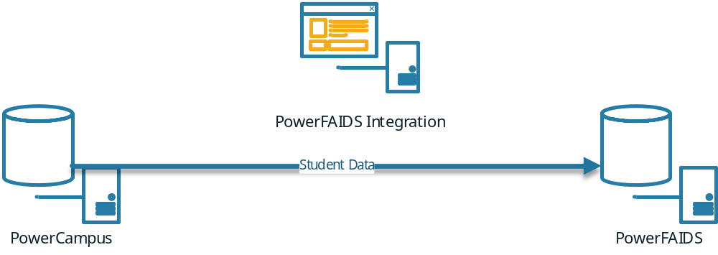
What is PowerFAIDS Integration?
Ellucian provided tool
Available in the Download Center
Notes:
PowerFAIDS Integration is an Ellucian provided tool for synchronizing data from PowerCampus to PowerFAIDS. The current version is 3.0 and it is available from the Ellucian Download Center. It is not capable of synchronizing data from PowerFAIDS to PowerCampus. That is the role of the PowerCampus Service Bus.

Slide 10
Table Name | Description | Where the info is set up | Where the info is visible
PFICodes | Special Codes setups | PCAMPUS - SysAdmin - Tools - Setup - PowerFAIDS Integration Mapping | PowerFAIDS Integration - Options - Special Codes
PFIColumns | Column names & mnemonics of PFAIDS columns in default mappings | PowerFAIDS - Administration - Dictionary (NOTE: Only some mnemonics allow new codes to be added) | PowerFAIDS - Administration - Dictionary
PFIErrorLog | Items not imported to External_Data table in PFAIDS |  | PowerFAIDS Integration - Options - Integration Errors OR SQL Server Management Studio
PFIMappings | Mappings set up in PC, default and by Year/Term | PCAMPUS - SysAdmin - Tools - Setup - PowerFAIDS Integration Mapping | PowerFAIDS Integration - Options - Data Mappings
PFIntegration | When the integration is run, this becomes the holding tank for Inq/App/Stu records that have had changes in data since the last pull (very useful for troubleshooting problems) |  | SQL Server Management Studio
PFIProcessID | One row at a time from PFIntegration is inserted here and evaluated for changes to send to PFAIDS |  | SQL Server Management Studio
PFISettings | Import Profile Header Info | PowerFAIDS Integration - Options - Integration Process | PowerFAIDS Integration - Options - Integration Process
PFITables | Tables that are scanned for changes |  | SQL Server Management Studio
PFITerms | Import Profile Detail Info (i.e., Inq/App/Stu selection, Year/Term, Award Year) | PowerFAIDS Integration - Options - Integration Process - Processing Terms | PowerFAIDS Integration - Options - Integration Process - Processing Terms
PFITranslations | PFAIDS-to-PCAMPUS code equivalencies by Year/Term | PCAMPUS - SysAdmin - Tools - Setup - PowerFAIDS Integration Mapping | PowerFAIDS Integration - Options - Data Translations
Notes:
PowerCampus is not only the source of the data to be synchronized, but also the backend for the integration tool. There are several tables that control and facilitate the integration program. The names of these tables start with PFI and are mostly interfaced through the System Administration workflow in the PowerCampus client software. Also important are several system Vista Views in PowerCampus. Like the tables, their name starts with PFI and they’re used to gather the data to be synchronized.

Slide 11
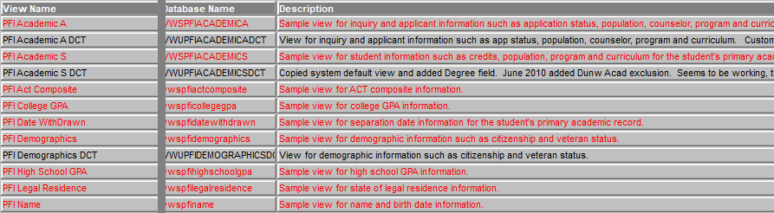
PowerFAIDS Vista Views
Used to provide data for the integration process
All begin with PFI in name
21 system Vista Views
  Only Academic has one for inquiries/applicants and another for students

Slide 12
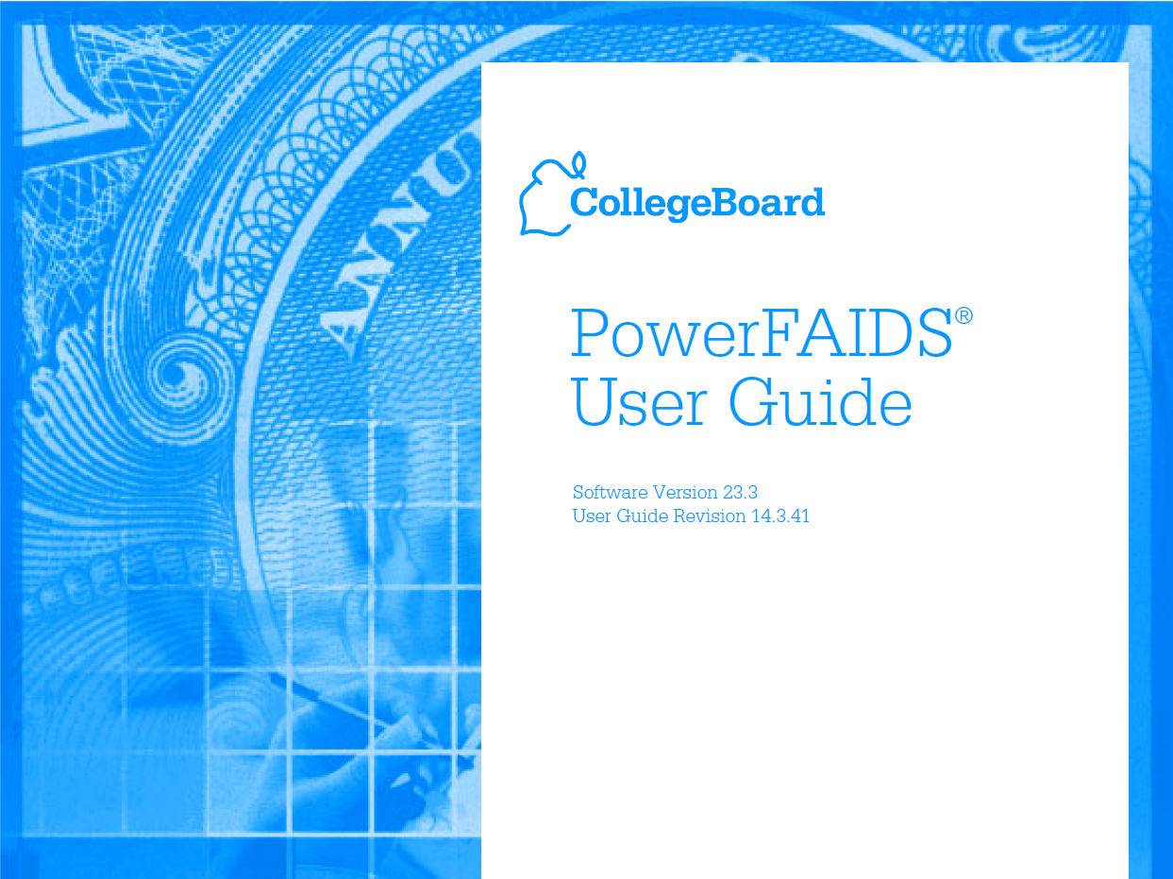
PowerFAIDS Import
Use PowerFAIDS external data integration functionality using the table method
Data in external_data table
Process in Chapter 23
Data definitions in appendix B
Notes:
The application doesn’t import data directly into the PowerFAIDS database. Instead, it deposits the data into the external data table in the PowerFAIDS database, and you can find the data definitions in appendix B of the PowerFAIDS User Guide. From there, we use the PowerFAIDS external data integration functionality to import the data into the PowerFAIDS database.

Slide 13
Installation and Configuration

Slide 14

PowerCampus Setup
Configure Third Party Packages
Add Financial Aid Award Year and Term to Academic Calendar
Review and create PFI Vista Views
Configure PowerFAIDS Integration Mappings

Slide 15
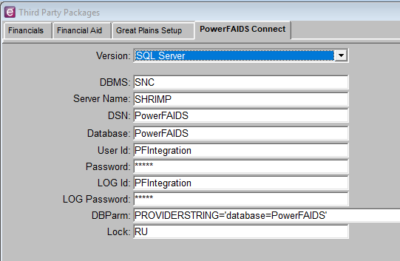
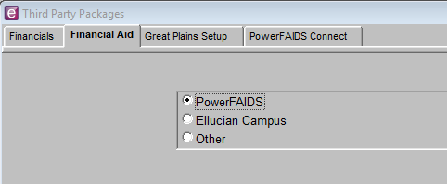
Third Party Packages
Notes:
Under Setup in System Administrator, we have to identify the financial aid system in Third Party Packages. On the Financial Aid tab, you choose PowerFAIDS. On the PowerFAIDS Connect tab, you have to provide the server and user information for connecting to your PowerFAIDS database. We created a service user account called PFIntegration for the integration. It has db_owner, db_datareader, and db_datawriter permissions to the PowerCampus database and db_datareader and db_datawriter permissions to the PowerFAIDS database.

Slide 16
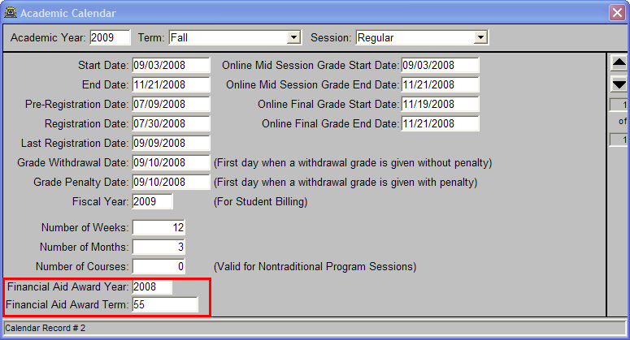
Academic Calendar
Do for every term
Look them up in PowerFAIDS at Administration – Campus Info section – Periods of Enrollment and Budgets or in the POE table.
Notes:
Academic Calendar has two fields in every year/term/session for adding the Financial Aid Year and Financial Aid Term. These must match the figures used for the corresponding PowerFAIDS POE. At Dunwoody, our financial aid award years are the first year of the school year, 2008-2009 in this case. Do this for every POE/Term combination.

Slide 17

A Note about Customizing Views…
Notes:
Let’s take a slight tangent here to talk about customizing the views. Although you can get all of the data elements you need from system Vista Views; the description for each one suggest that you should copy the view logic to a user view and customize it to meet your needs. If you do this, before to join the PFI Integration table to make sure you’re providing it for the correct student in the correct year/term.
As you may have noticed in the previous screen, we did that and appended DCT to the end of the name to tell them apart. All of them are copies of the original system view, but have a slight variation to make the view fit our needs or add information not normally included. For example, we’ve been asked to add the Credits Taken from the student’s academic plan. We’re adding it to our PFI Academic S DCT view and will then add a mapping to the field.

Slide 18
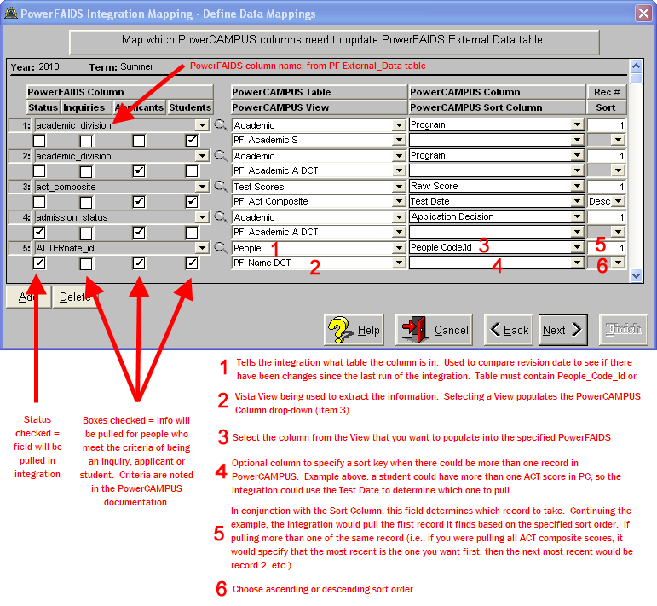
PowerFAIDS Integration Mapping
Need a mapping for every term
Map Alternate ID to People Code Id
Copy forward mappings from term to term
Data stored in PFIMappings
Notes:
Mappings and Views: The last setup task within PowerCampus is the field mappings between PowerCampus and PowerFAIDS. You will find this under PowerFAIDS Integration Mapping under System Administrator, tools, setup. Each year/term/session has a mapping configuration. You have a default mapping to start from, but once you’ve defined a term, it is recommended you copy forward the mapping from term to term because this will ensure any changes get copied forward too. If you make changes to a term’s mapping, then you must repeat those changes for every subsequent term you have already defined a mapping.
One mapping that we do think is important is the alternate id. As you can see here, this is where we map the People Code Id so that both systems have the primary person identifier of the other system.
Clicking into a term’s mappings gets you a window where you see PowerFAIDS fields from the external_data table on the left and PowerCampus tables and views on the right. Active fields have a check in the status box and each field can be narrowed to apply to inquiries, applicants, and/or students. Your job for each active field is to define the data element that will be copied if the system detects a change in a PowerCampus table.

Slide 19
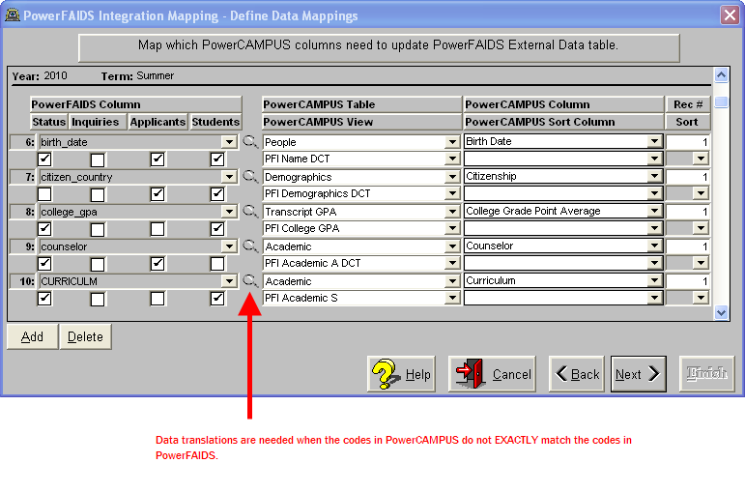
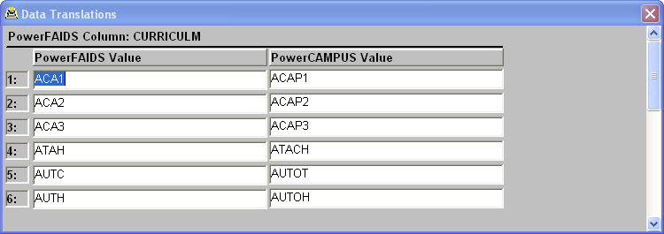
Data Translations
Notes:
Clicking on the magnifying glass allows you to define any data changes required to make data from PowerCampus fit in the structure of the PowerFAIDS database. For example, the maximum size of a PowerFAIDS major is 4 characters, so if you have curriculums in PowerCampus larger than 4 characters, then you need to provide a translation.

Slide 20
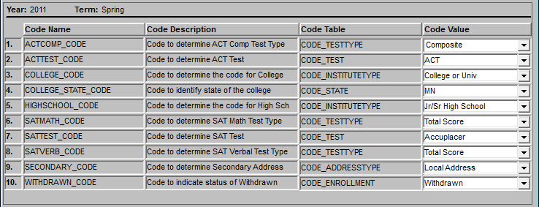
Special Codes
Last screen for each term mapping
Used to map the PowerFAIDS code to the PowerCampus code
Notes:
Lastly, you have to define what the tool can use for special codes. Much like before, you are mapping the PowerFAIDS code for a value to the PowerCampus code value.

Slide 21

PowerFAIDS Integration Setup
ODBC (32-bit)
Application Installation
Add a Profile

Slide 22
Where to Install?
Dedicated Virtual Machine
  Hard Limit on all resources
  Dedicated PFI account
  Connect via Remote Desktop with PFI account
    Always disconnect, never log out
  Hardware
    1 Processor
    2 GB RAM
    30 GB HDD
  Software
    Windows 7 Enterprise
    PowerFAIDS Integration
    PowerFAIDS
Notes:
We created a dedicated VM for running both the PowerCampus Integration and PowerFAIDS Scheduler service. (We found PowerCampus Integration to be a resource hog, so we placed a hard limit on the VM’s processor speed.) We use Remote Desktop Connection to connect to this VM and log on with a dedicated user account. Using a dedicated account is important here because the PowerCampus Integration application must remain running in order for the scheduled scans of PowerCampus to occur. Therefore, we disconnect when we are finished with the machine.

Slide 23

PowerFAIDS Integration App Installation
ODBC (32-bit) to PowerCampus and PowerFAIDS databases
Use all defaults
Notes:
PowerCampus Integration uses 32-bit ODBC connections to connect to PowerCampus and PowerFAIDS.

Slide 24
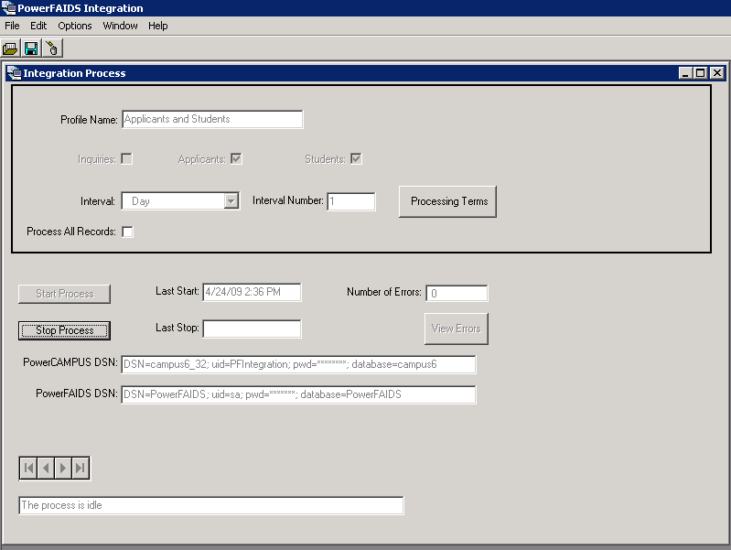
Integration Process Profile
Identify groups to insert
Set interval for scans
Notes:
To have the application automatically get data from PowerCampus, you need to set up a profile for the groups of students you’ll scan, the interval of the scan, and the terms that you are processing. If you need to process all records, regardless of if something has changed, then place a check in the Process All Records box; otherwise, leave it unchecked for normal operations.

Slide 25
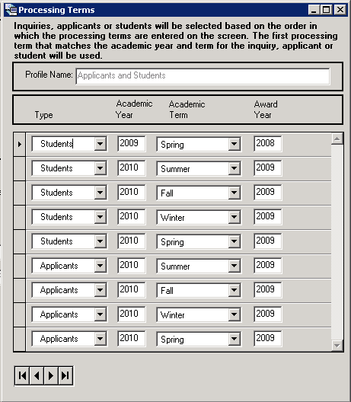
Processing Terms
No more than 6 POE
Processes in top-down order
Remove rows per policy

Slide 26
Start/Stop Process
Start and leave running
Stop if you need to do anything else
Notes:
Obviously, these two buttons start and stop processing. For normal operations, you leave it started and it will process records per the defined interval. If you need to do anything else, such as run PowerFAIDS, then you must stop processing, because – as I noted before – this application is a resource hog.

Slide 27
PowerFAIDS Setup
Start the PowerFAIDS Scheduler service
Manually or schedule PowerFAIDS import
Manage PowerFAIDS Scheduler queue

Slide 28
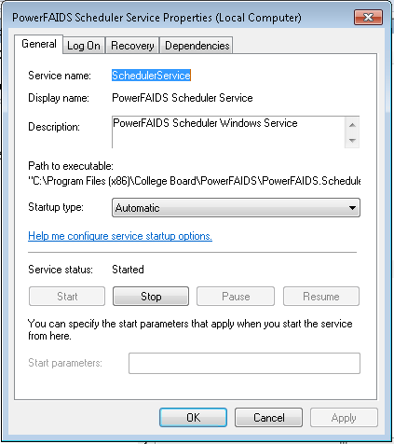
PowerFAIDS Scheduler Service
Notes:
As I’ve noted before, PowerCampus Integration doesn’t actually import the data into PowerFAIDS. It puts the data into the PowerFAIDS external data table. It is not usable there. We rely upon PowerFAIDS to import the data from the external data table into rest of PowerFAIDS. Thus, we get to the other reason for using a dedicated VM. The PowerFAIDS Scheduler is a service which will run a job we scheduled within the PowerFAIDS application. We’ve set up jobs – one for each financial aid year -- to do an import every day at 6 AM.

Slide 29
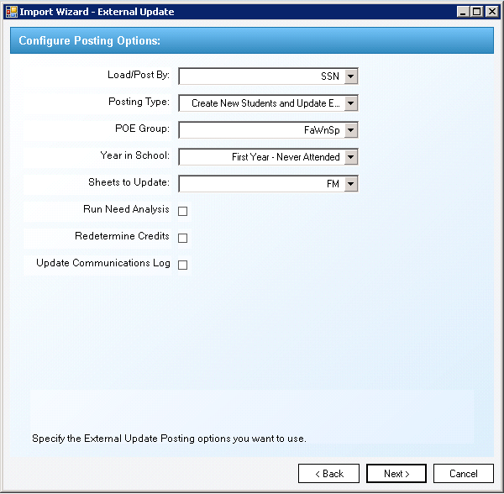
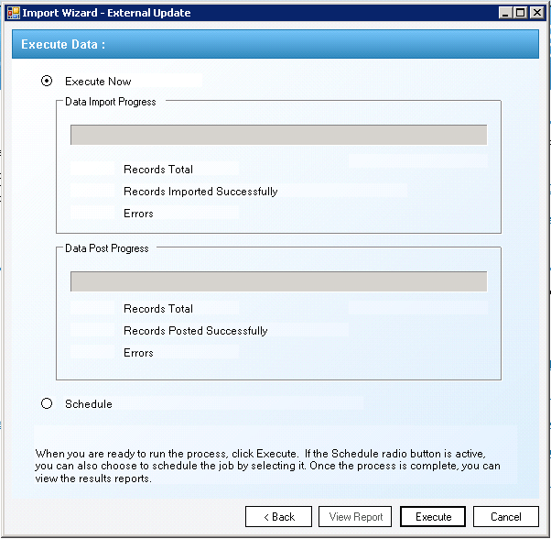
Import External Data Wizard
Done in PowerFAIDS
Imports one award year only
Located under Data Integration Tools
Choose External Update
Choose Table
Notes:
You can manually import data using the PowerFAIDS application. Under Data Integration, select External Update and choose table as the source. We leave every other option as the defaults. The last screen gives you the choice of running the import immediately or scheduling it. We only run it manually if we’re resolving an issue.

Slide 30
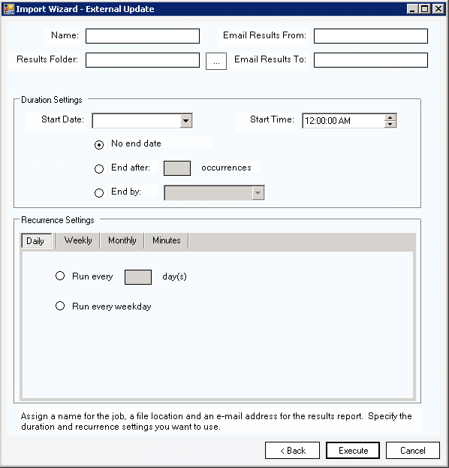
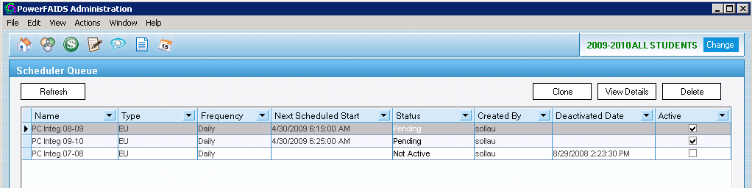
PowerFAIDS Scheduler Queue
Queue located under Administration
Select Scheduler Queue from View menu
Each award year needs a job in the queue

Slide 31
Care and Maintenance

Slide 32
Weekly and monthly maintenance
Weekly
Monthly
Search for bad SSNs
Check for credit mismatches
Check for NULL names
Check log tables
Stop/Start Processing
Check for NULL FICE (FAFSA) codes
  https://ifap.ed.gov/ifap/fedSchoolCodeList.jsp
Check for new POE rows in PowerFAIDS
Notes:
Although we find the Integration program runs without a whole lot of input from us, we do find that we have to perform regular maintenance. These are the tasks we run every week and month.
The number one problem we run into – one that will stop the program in its tracks - is bad SSNs. It’s the PowerFAIDS key identifier for students. Therefore, we look for any government ID that is not 9 digits.
Also every week we check for any credit and name synchronization mismatches and the import log files for both systems.
I also find that the ODBC connection to the databases is sensitive to any disruptions, so we try to stop and start the Integration process at least once a week. If the ODBC connection has failed, then we have to restart the application.

Slide 33
Annual and periodic maintenance
Add or remove terms from processing terms
Update Academic Calendar
Review PowerFAIDS Appendix B for new fields
Add or edit mappings (e.g., new curriculums, additional fields, etc.)
Copy forward mappings to new terms
Purge integration records
Schedule new award years

Slide 34
Error messages & Troubleshooting
Error Number | Description | Resolution
1 | External_Data record is being loaded. | Not an error
2 | Value too large for column | Fix the data
3421 | Application uses a value of the wrong type for the current operation. | Check the SSN
3265 | Item cannot be found in the collection corresponding to the requested name or ordinal. | Check data translations
-2147217871 | Query timeout expired | Restart PowerFAIDS Integration

Slide 35
Your Questions and Discussion

Slide 36
Thank You!
Chad Strunk
cstrunk@dunwoody.edu

