Slide 1

PowerCampus Vista Views: 101
A spoon full of sugar helps the data come out
PowerCampus Version 8.5.2
Vista Views (SQL 2008 Compatibility)
Presented by: Anthony Williams, Dir. Of Institutional Research
Institution: MCNY
Date:6/12/2015

Slide 2
What is Vista Views?
A tool used to create custom views with Vista Reports
Users can select pre-defined tables and other custom views
Views and tables can be secured by profile, user name/operator id, or formal name (for your taste buds only)
Users can add columns, create joins, develop where clauses, group by, sort, and customize data

Slide 3
Why Use Vista Views?
An easy to use interface for individuals to create reports
Non-tech savvy individuals will appreciate the tabulated format
Custom views can easily be modified without implementing heavy SQL coding
Data can be extracted into various formats (.xls, csv, txt, pdf, etc)

Slide 4
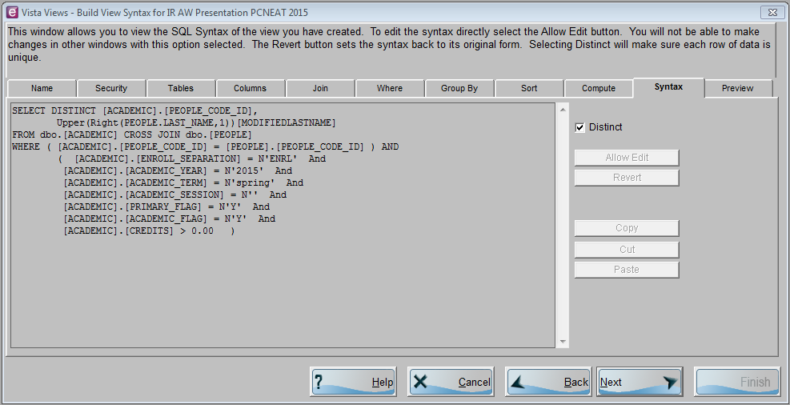
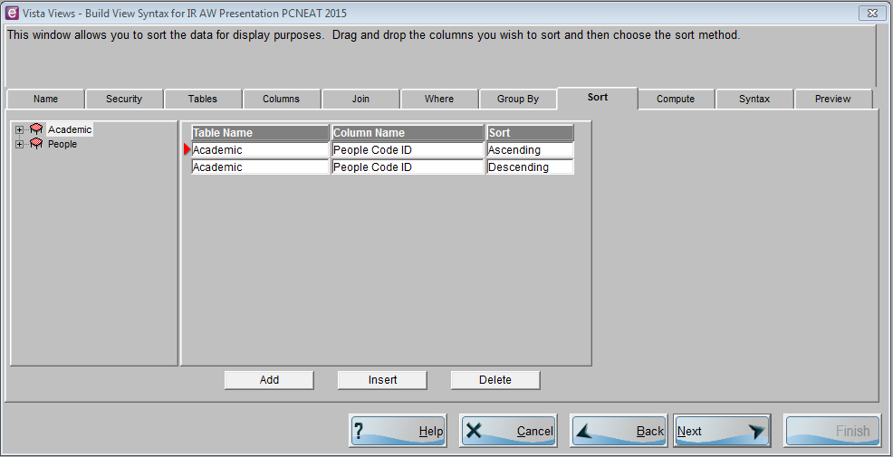
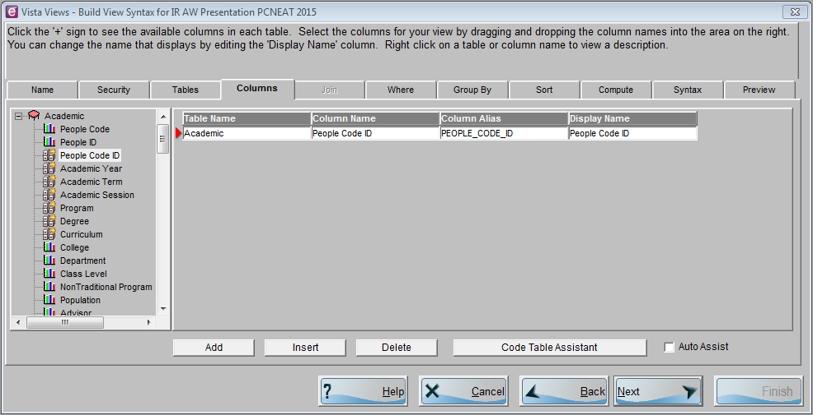
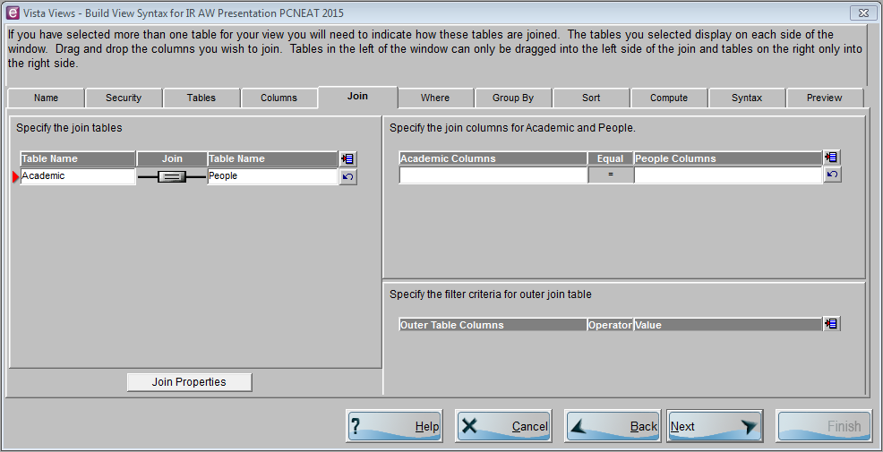
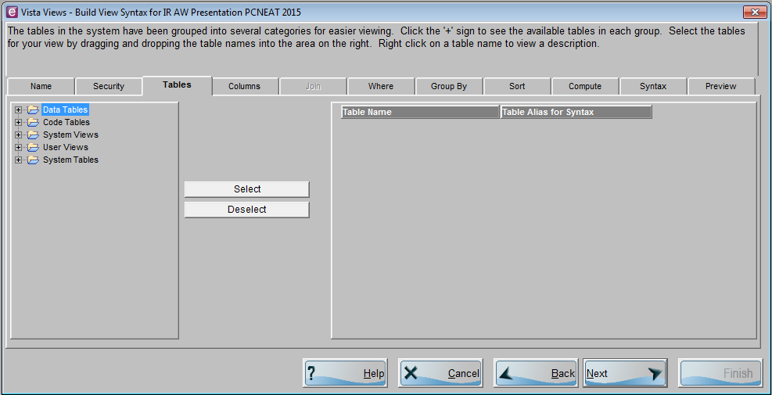
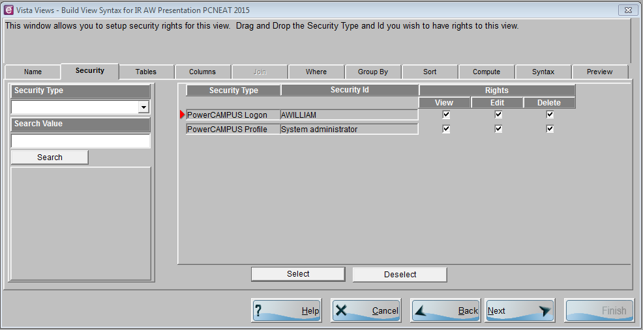
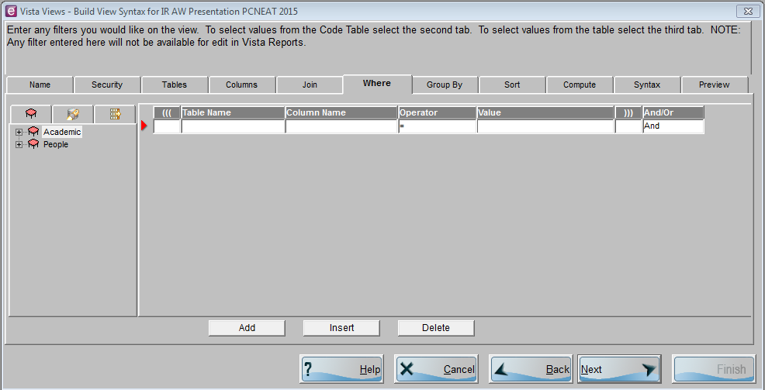
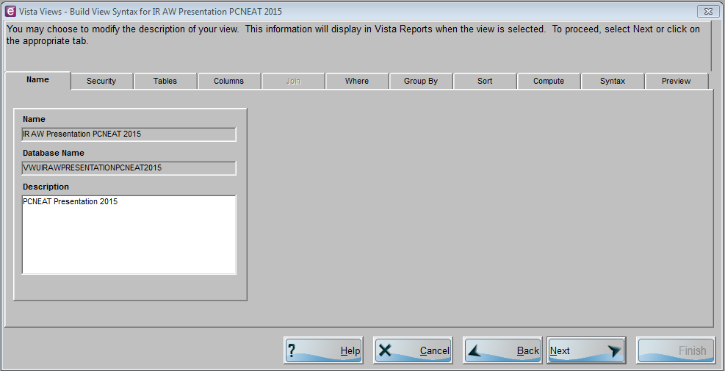
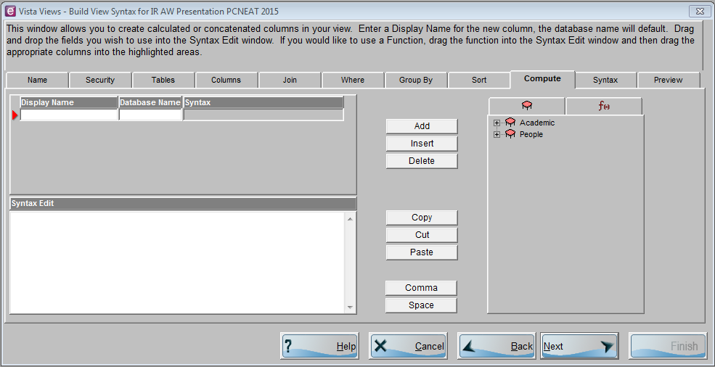
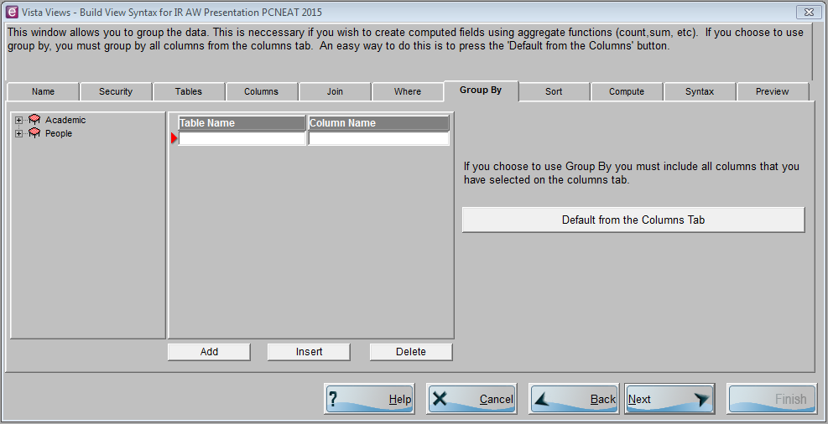
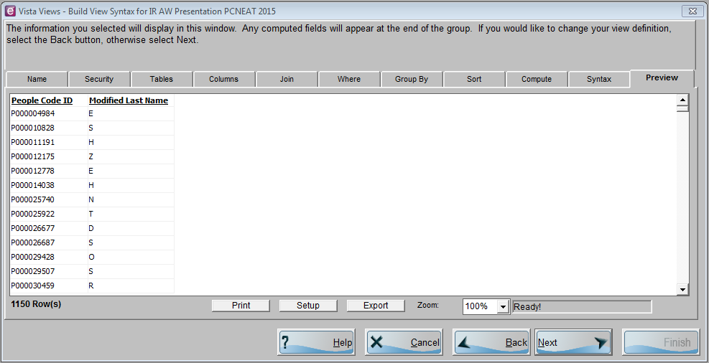
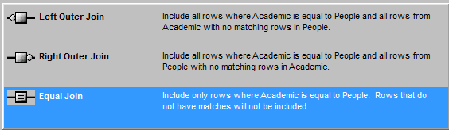
Where is the sugar and How is it used?
Custom views, pre-defined tables, security settings, and other important features (joins, where clauses, group by, sort, compute, syntax, preview)
Preview shows results from the SQL syntax tab
Compute allows the user to:
Customize reports for requestor’s use, personal use, or meeting other reporting needs by
Data Tables – Holds data on inquires, applicants, students, and an array of other important information
Code Tables – Hold the various user-defined code tables for your institution
System Views – Hold any system-defined views which are currently on the system
User Views – Hold any views that you have created
System Tables – Holds the various system tables which are currently on the system
Where clauses filter data. Some examples include:
Defining a specific year, term, and/or session
Defining a specific program, degree, and/or curriculum
Separating applicants from enrolled students
Excluding graduate students from the results
Group By is a feature used to group data. Examples include:
Displaying the number of classes a professor is teaching
Displaying the number of classes that are either online, traditional, or hybrid
Columns tab allows the user to select the columns needed for the report. Examples include:
Enrolled Status
Credits Currently Enrolled
Full/Part Time Status
Academic Standing
What tables are going to relate to each other?
How are the tables going to relate to each other?
Type of Join
Columns in common
Manipulating strings and dates
Performing mathematical computations
Working with null values
Rows can be unique by clicking Distinct
Syntax tab allows the user to edit the SQL syntax directly (System Administrator Role)

Slide 5
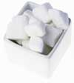


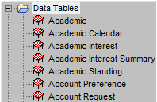


What type of sugar is needed? (Tables Tab)
Types of Sugar:
      White Sugar
      Brown Sugar
      Liquid Sugar
Types of Tables:
      Data Tables
      Code Tables
      System Tables

Slide 6
Data Tables
There are hundreds of data tables from A to Z (Academic - Zip Code)*
Data Tables regularly used by Institution Research at MCNY
Academic | People
Action Schedule | People/Organization Balance
Address Schedule | Person Phone
Degree Mapping NSC | Section Personnel
Demographics | Sections
Education | Telecommunications
Grade Value | Transcript Degree
Nontraditional | Transcript Detail
Organization | Transcript GPA
* Viewing rights for each table will depend on a user’s security setting

Slide 7
Data Tables Cont.
Tables
Academic – Inquiry, Applicant, and Student information
Action Schedule – Actions pertinent to the institution
Address Schedule – Current and Historical address information
Degree Mapping NSC – Columns relevant to the NSC
Demographics – Gender, Ethnicity, Marital Status, Citizenship, etc
Education – Relevant information from prior institutions
Grade Value – Grading information (Passing or Failing marks)
Nontraditional – Academic programs not on a traditional semester
Organization – Organization information (Institutions)
Key Columns
People Code ID, YTS, PDC, Prim. Flag, Acad. Flag, Enrolled Status
People/Org Code ID, YTS, Action ID, Action Name
People Org Code ID, Address Type, Status
YTS, PDC
People Code ID, YTS (Blank)
People Code ID, School (Organization Code ID)
YT, Grade, Credit Type
NonTraditional Program
Organization Code ID, Organization Name
Notes:
Academic Table
YTS – Year, Term, Session
PDC – Program, Degree, Curriculum
Prim. Flag (Primary Flag) – allows the user to select one PDC record to avoid duplicated counts
Acad. Flag (Academic Flag) – Indicates the individual is a student
Degree Mapping NSC
NSC – National Student Clearinghouse

Slide 8
Data Tables Cont.
Tables
People – Name, SSN, Preferred Address, Birth (dates/location)
People/Organization Balance – Balance types
Person Phone – Phone numbers and phone type
Section Personnel – Identification for Faculty
Sections – Course Information (Adds, Drops, Times, Room Type)
Telecommunications – Active and Inactive email addresses
Transcript Degree – Graduate Information
Transcript Detail – Grade and Course information for students
Transcript GPA – GPA informaton by C.O.S.T.
Key Columns
People Code ID, Preferred Address, Primary Phone ID, Person ID
People/Org Code ID, YTS
Person Phone ID, Person ID
Personnel ID, Course ID, Course Sub Type, Section, YTS
Course ID, Course Sub Type, Section, YTS
People Org Code ID, Com Type, Primary Flag, Status
People Code ID, PDC, Graduation Date
People Code ID, YTS, Course ID, Course Sub Type, Section
People Code ID, YTS, PDC, Record Type, Transcript Sequence
Notes:
People/Organization Balance
Balance Types – Fiscal Year, Academic Year, Academic Year/Term, Academic Year/Term (Cumulative) and Current
Telecommunications
Currently storing alternative email addresses
Transcript GPA
C.O.S.T. – Cumulative (Session), Overall (Term Cumulative), Session, Term

Slide 9
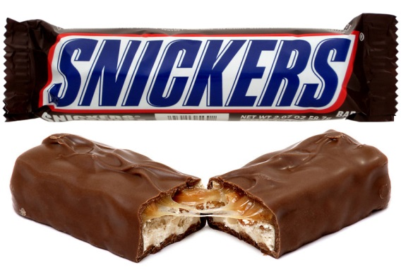
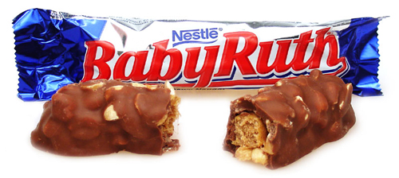
How are these candies alike?
Both Candies Have:
Sugar
Milk Chocolate
Peanuts
Caramel
Blue and red colors in their labeling
Eight letters in their name

Slide 10
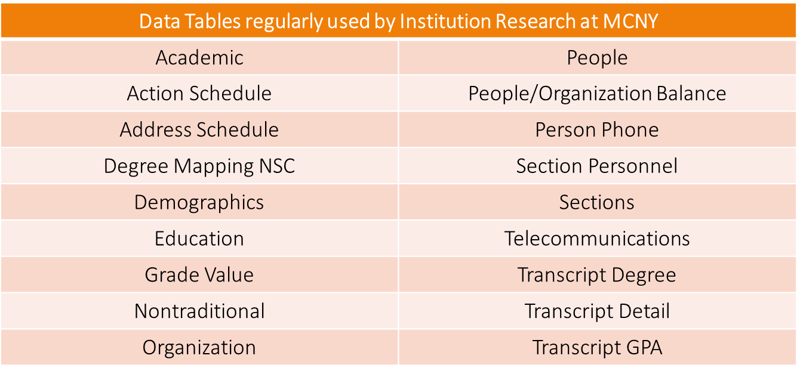
Data Tables Can Relate to One Another
Both Data Tables Can Have A:
People Code ID
Year, Term, Session
Program, Degree, Curriculum
Course ID, Course Sub Type, Section
Transcript Sequence
Credit Type
Grade
And Many Many more….

Slide 11
Data Tables Can Relate to One Another Cont.
Joins are needed when selecting more than one table
Tables need to relate to each other in order for syntax to run successfully
Joins help to relate tables to one another

Slide 12
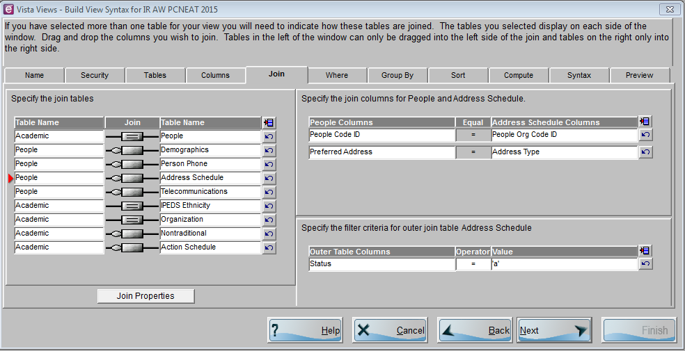
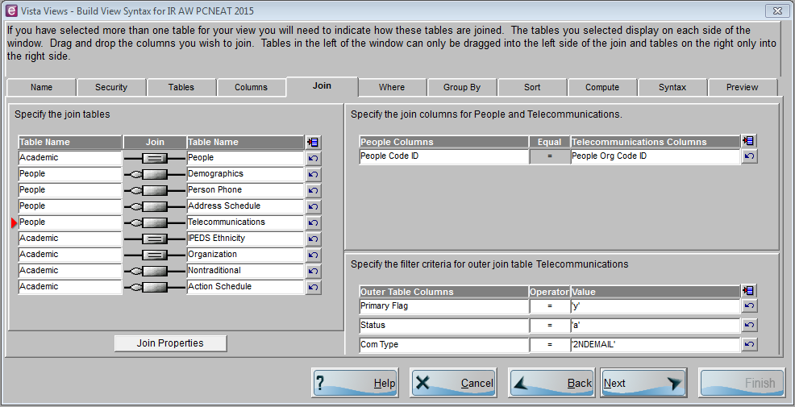
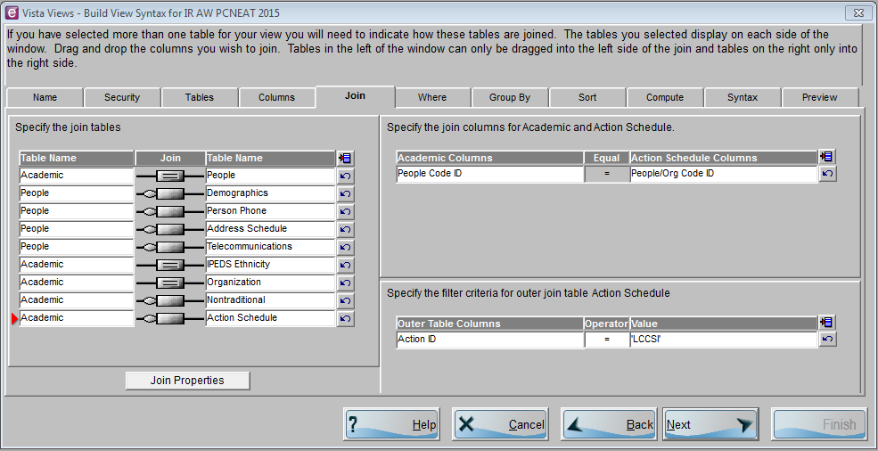
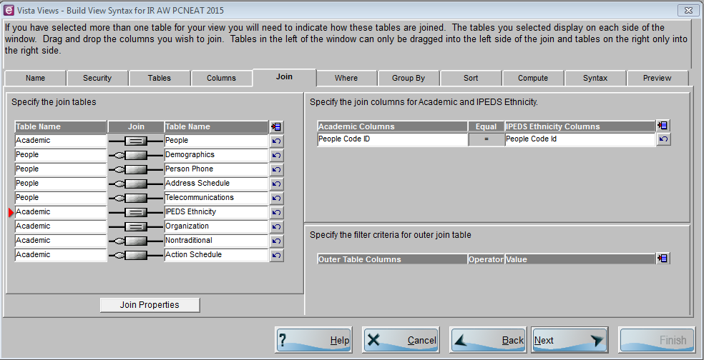
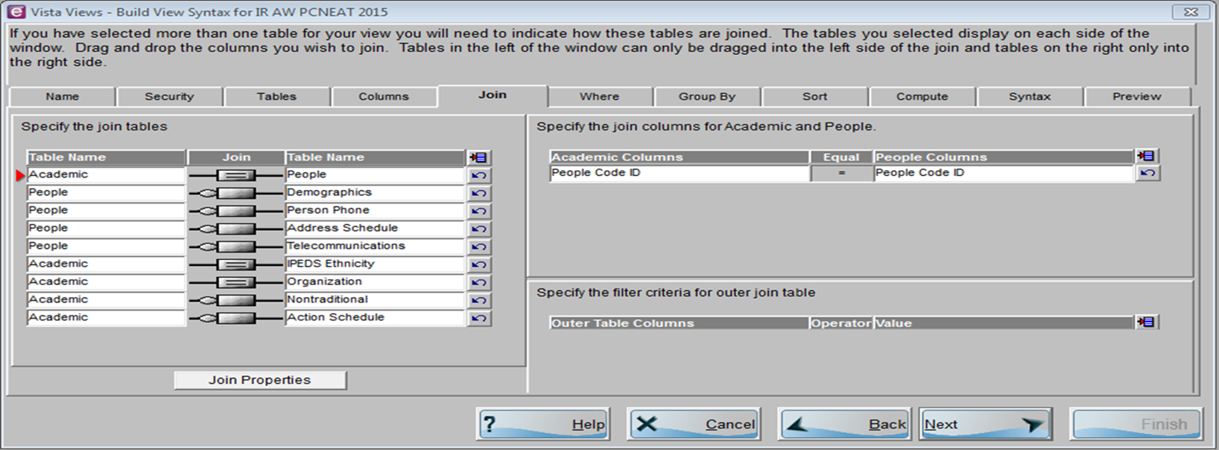
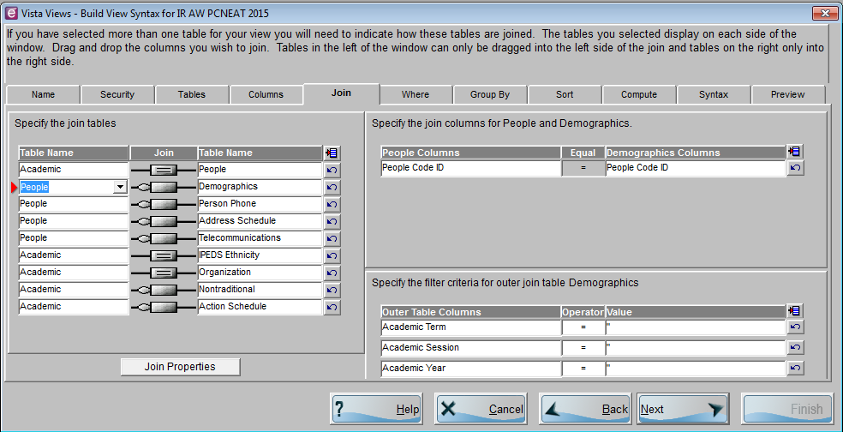
Data Table Relating Examples
People Code ID
People Code ID
People Code ID
People Org Code ID

Slide 13
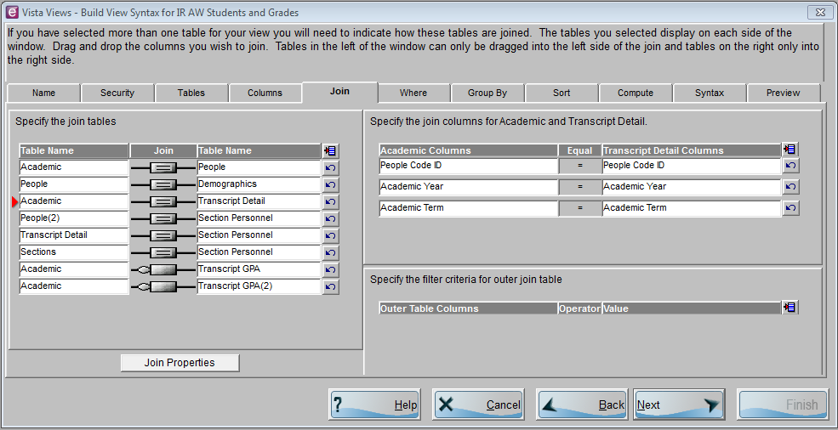
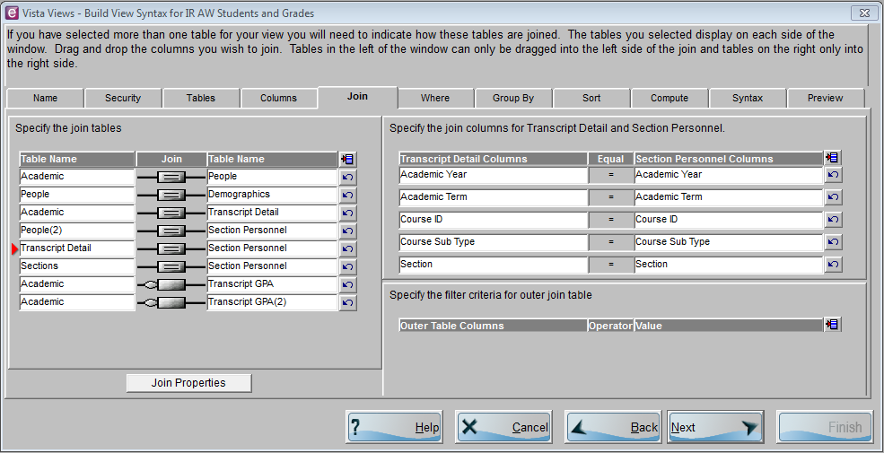
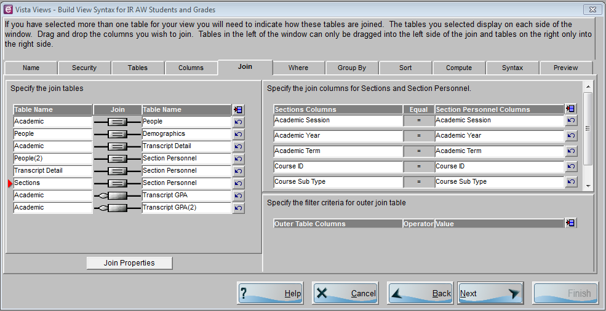
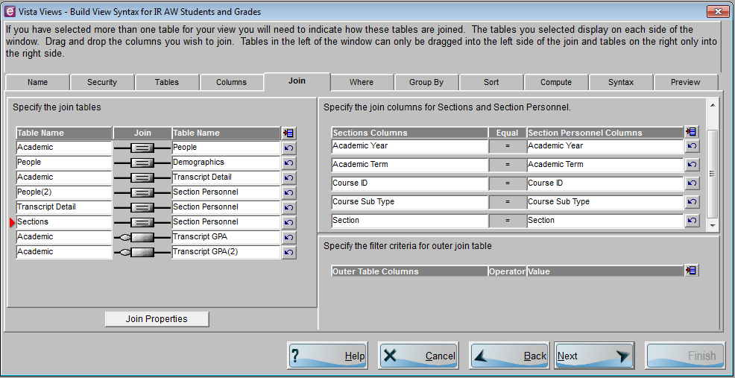
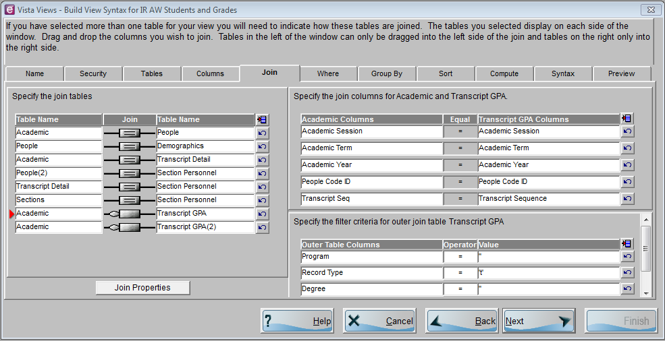
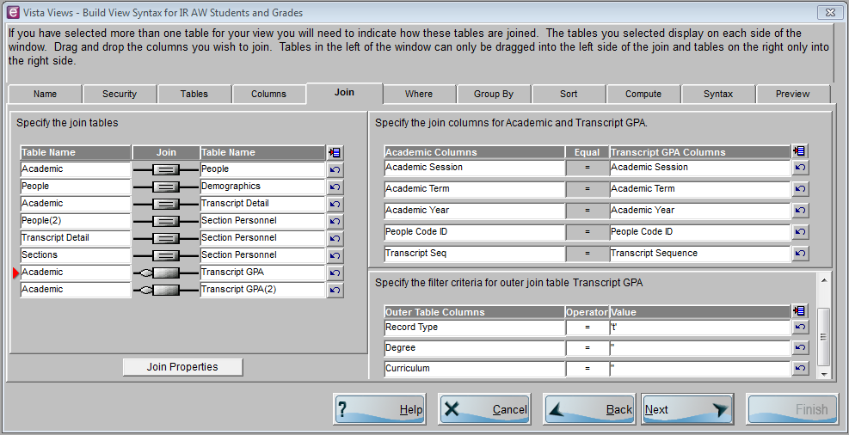
Data Table Relating Examples Cont.
Academic Y, T, S
Academic Y, T, S

Slide 14
Reporting Requests
Question 1*
Academic Affairs would like a list of all currently enrolled students along with their program, degree, curriculum, credits, college attend status, and population.
Question 2*
Academic Support would like to contact newly enrolled students via email about the services they provide.
Question 3*
The Human Services Department would like a list of all their currently enrolled students and their subsequent courses.
* Credits > 0

Slide 15
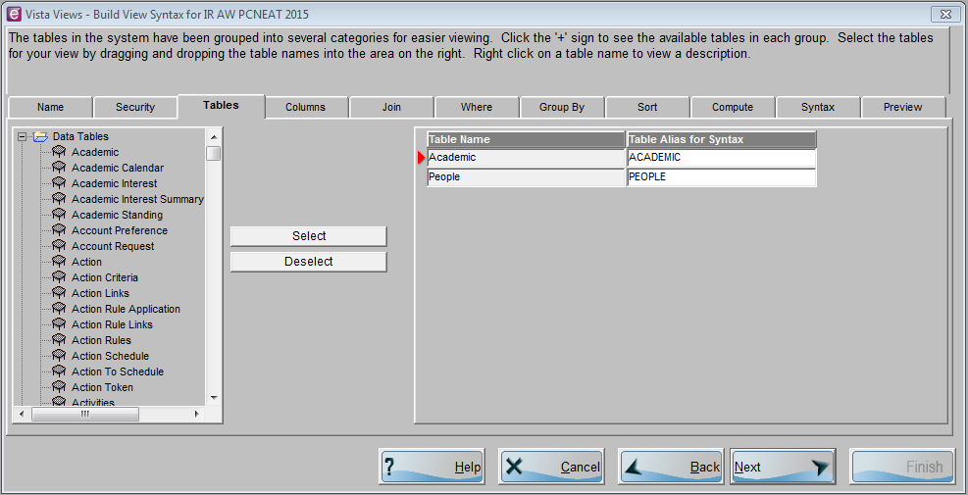
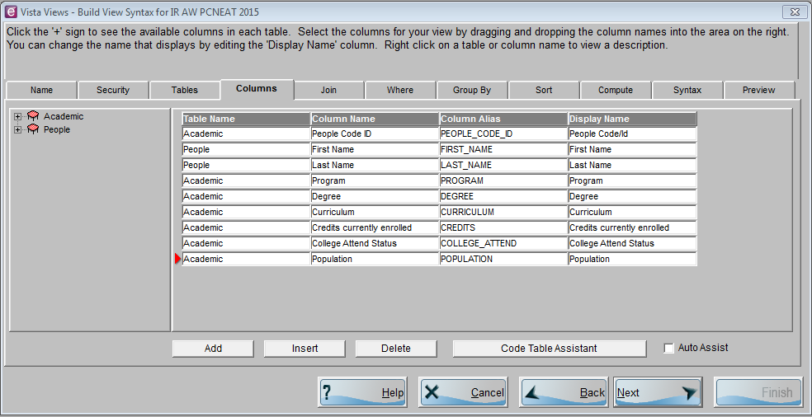
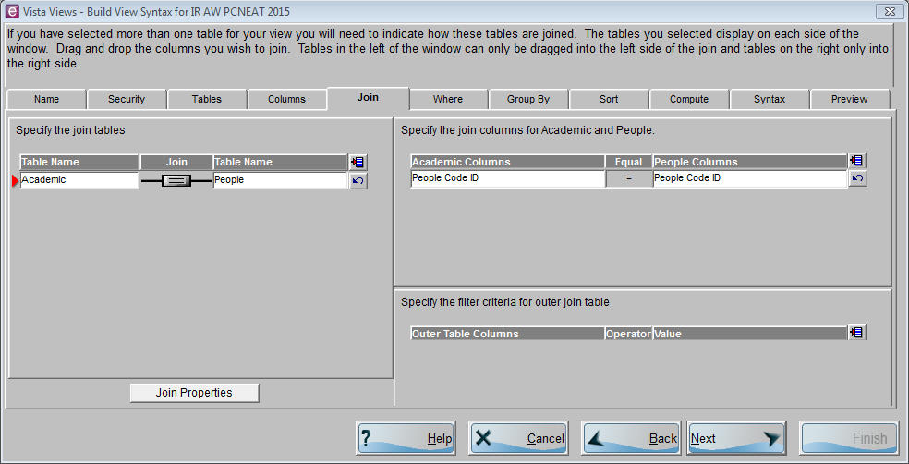
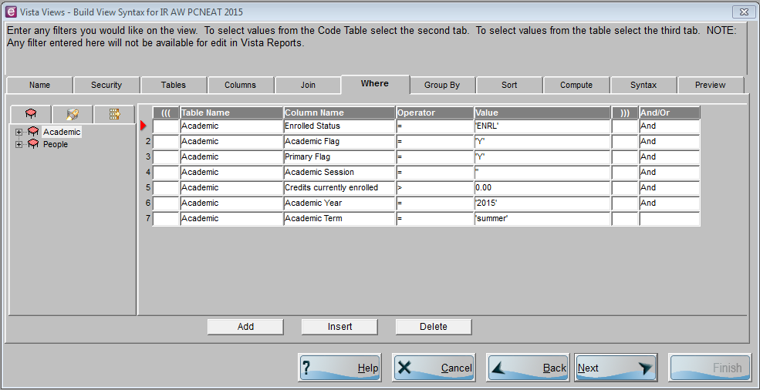
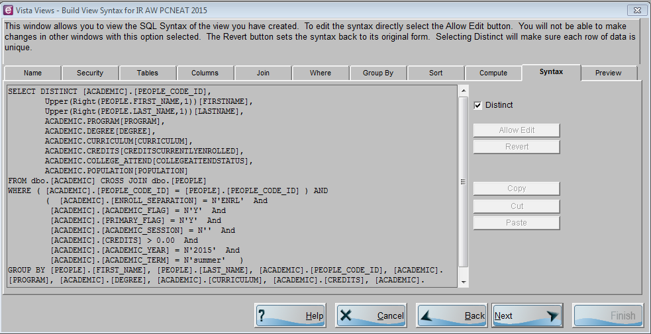
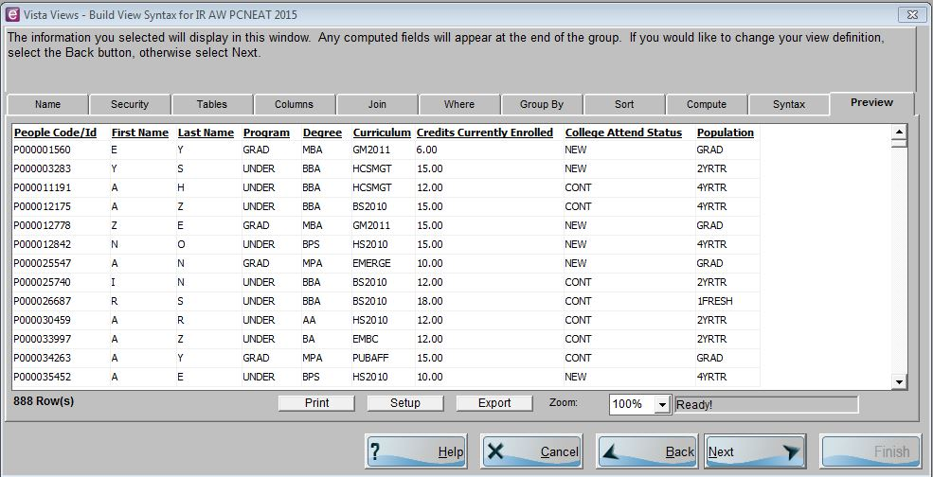
Relating Data Tables to Build Reports
Academic Affairs would like a list of all currently enrolled students along with their first name, last name, program, degree, curriculum, credits, college attend status, and population.

Slide 16
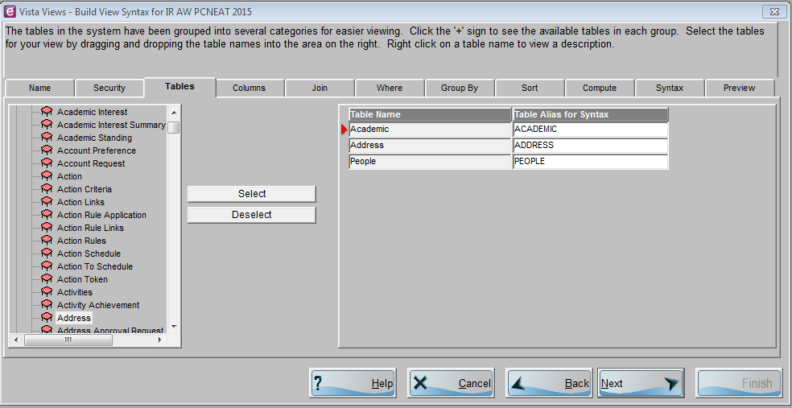
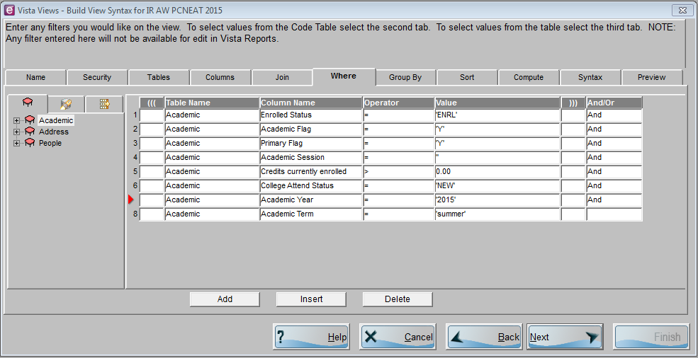
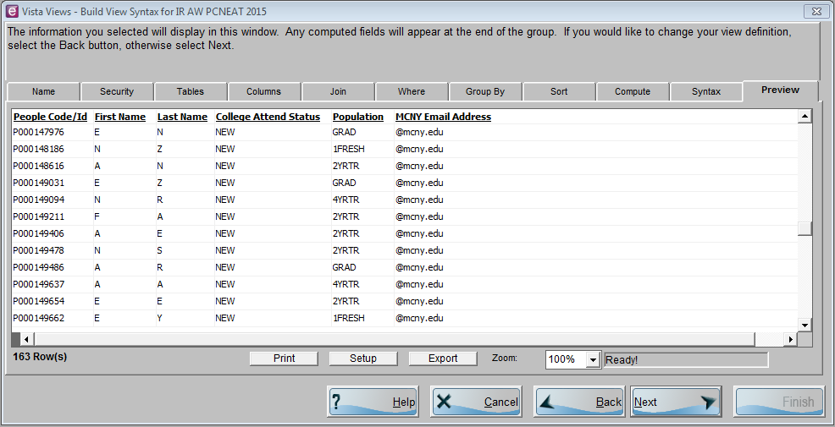
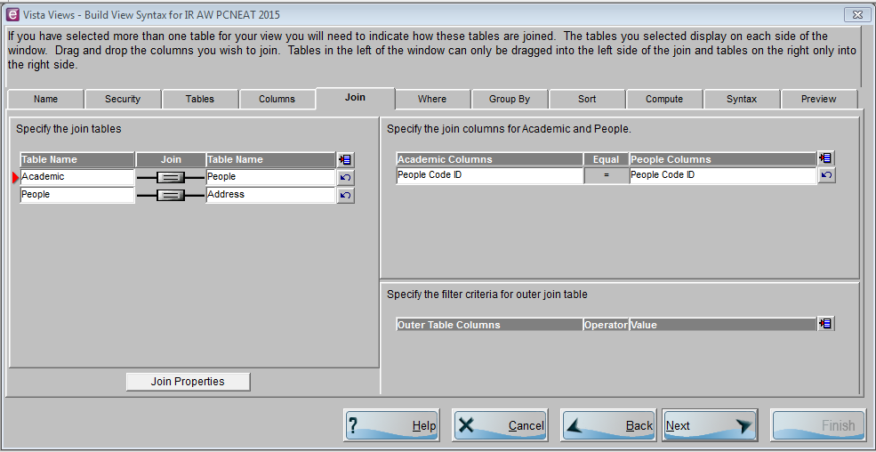
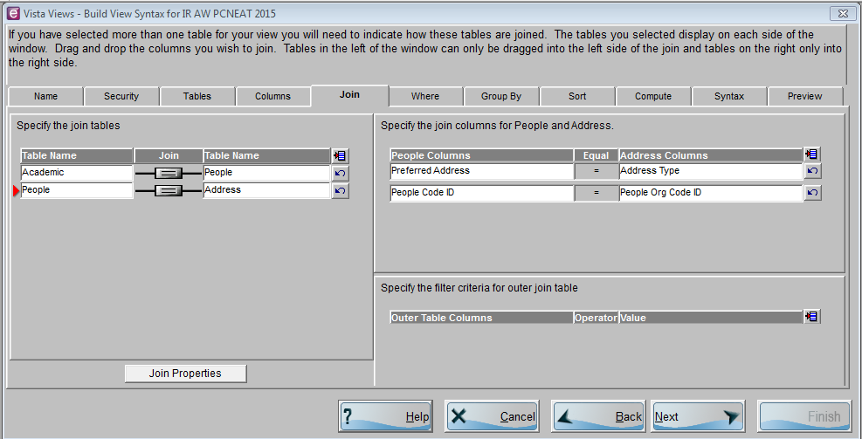
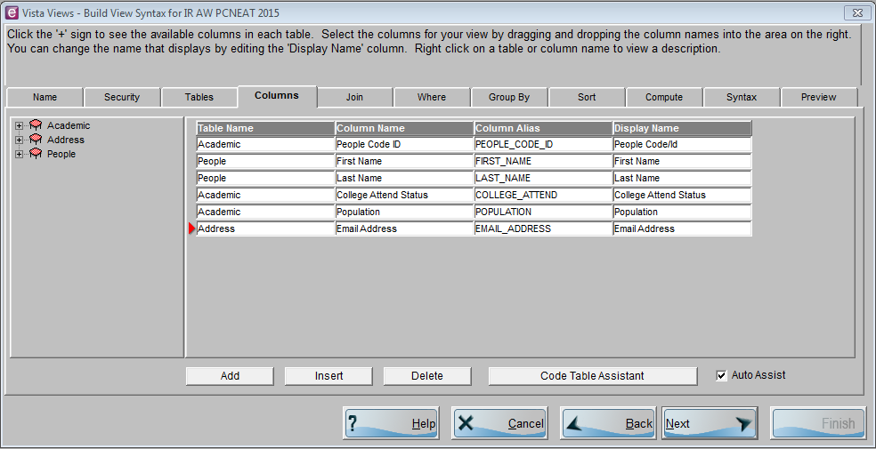
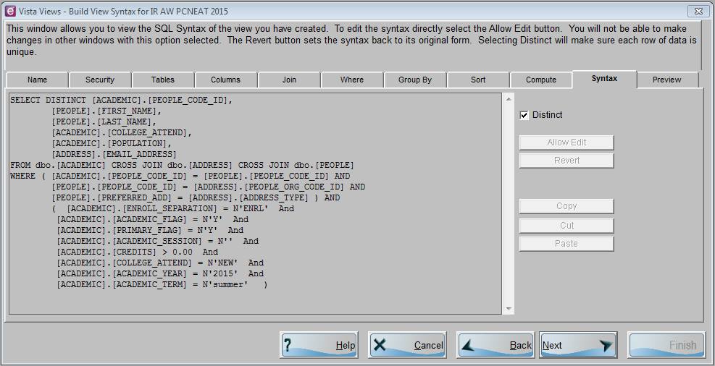
Relating Data Tables to Build Reports
Academic Support would like to contact via newly enrolled students via email about the services they provide.

Slide 17
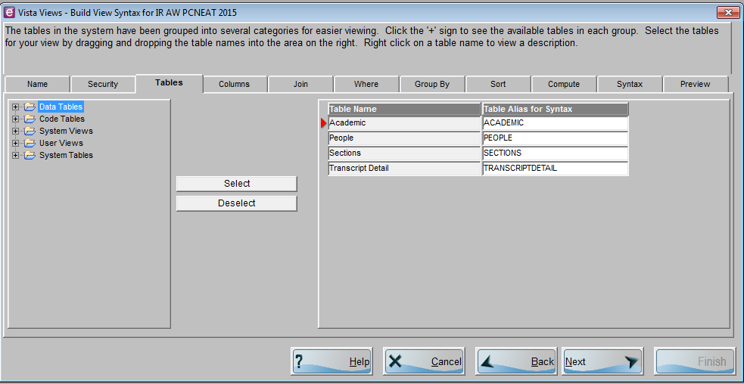
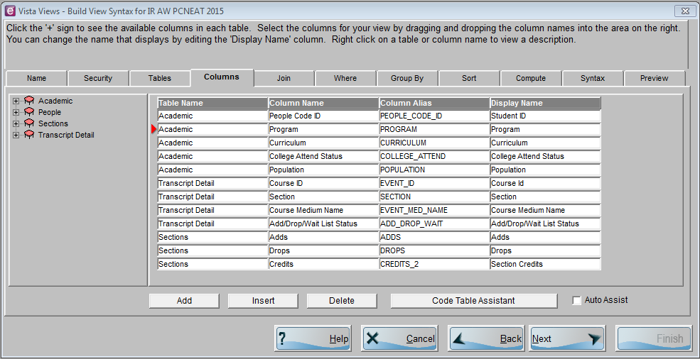
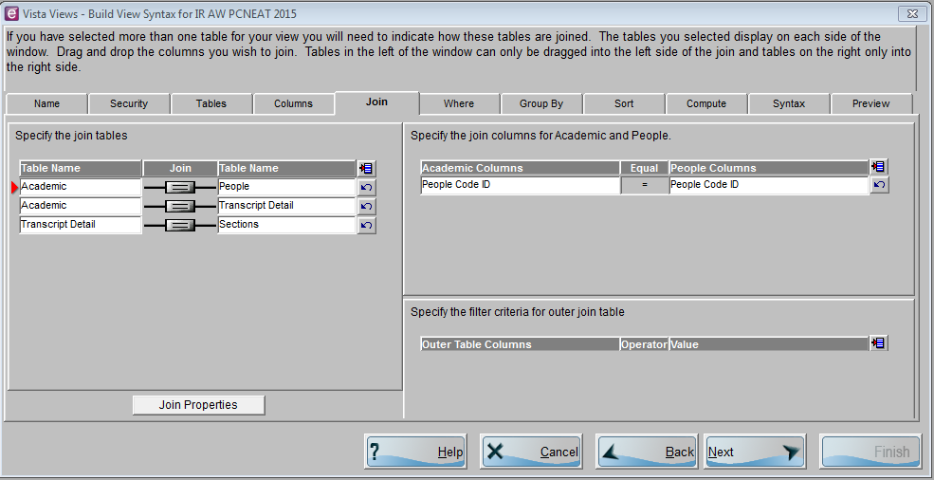
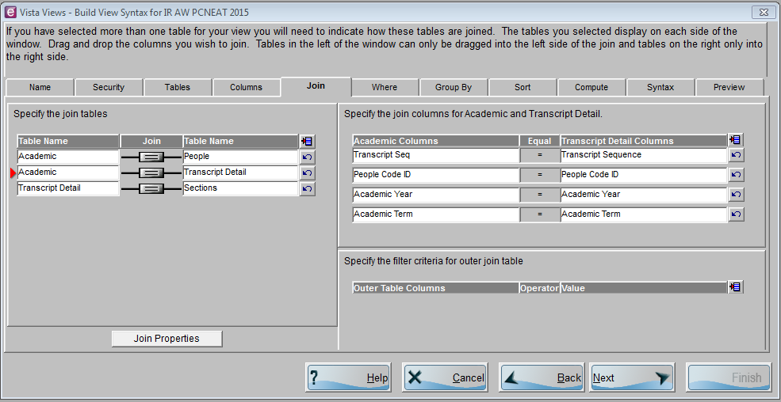
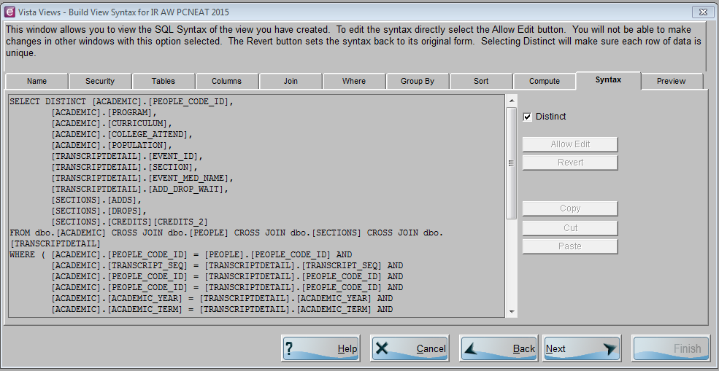
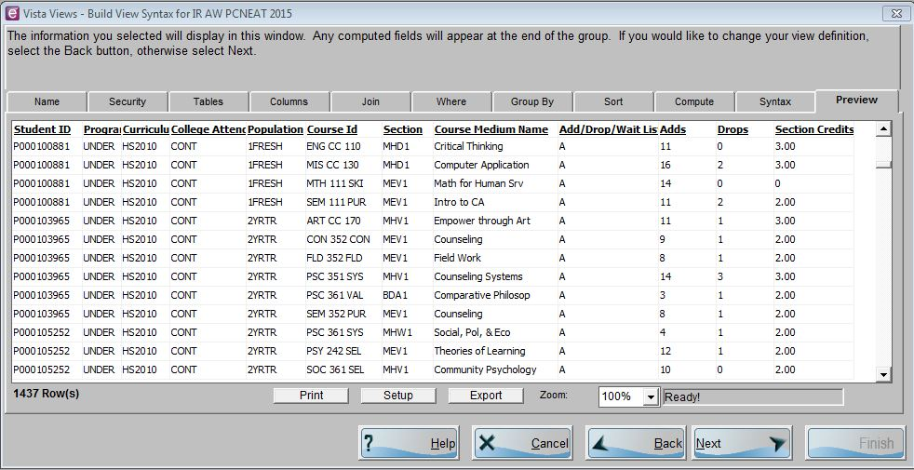
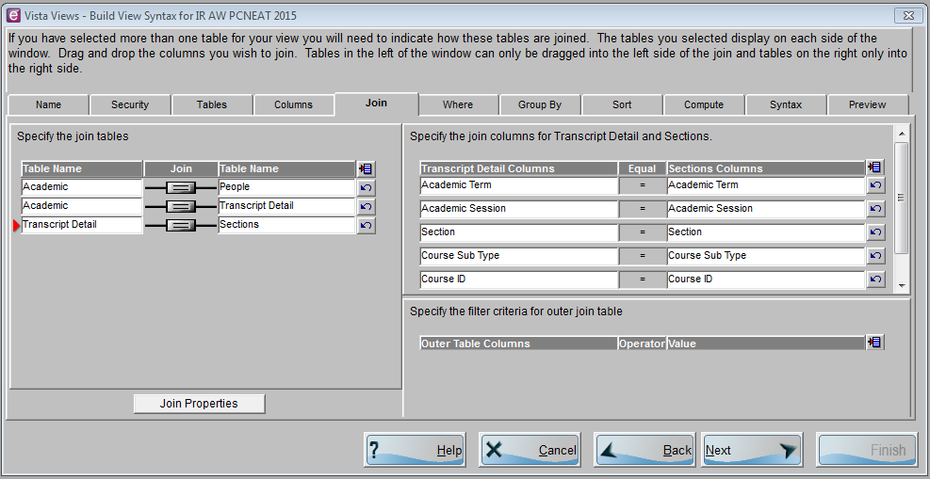
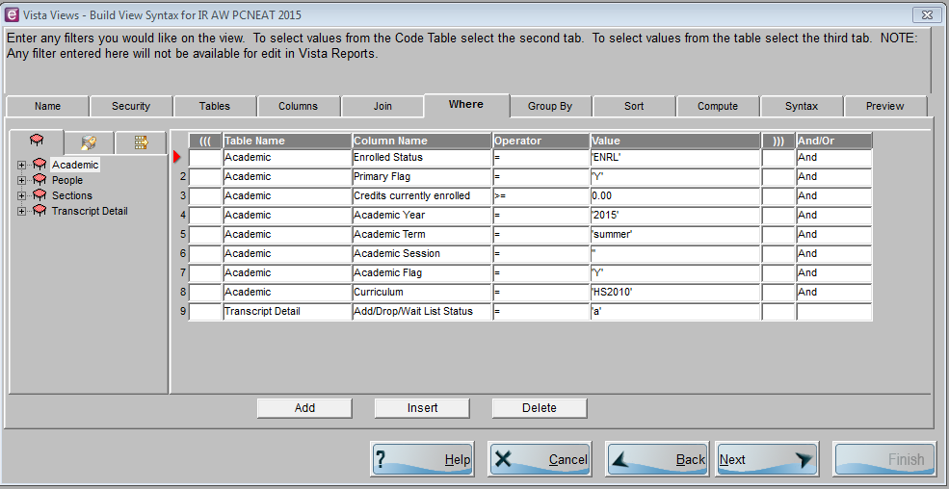
Relating Data Tables to Build Reports
The Human Services Department would like a list of all their currently enrolled students and their subsequent courses.

Slide 18








Code Tables
Example
Store specific values defined by the institution
Allow users to understand certain data fields
Add a field that stores specific value (Red cursor is on that field)
Click Code Table Assistant
Select the following options

Slide 19


References
Vista Views
PowerCampus Documentation Archive Release 8.4. (n.d.). Vista Views. Retrieved from http://www.powercampus.com/pcampusdocs/vista/w_view_wizard.html
Code Tables
PowerCampus Documentation Archive Release 8.4. (n.d.). Code Tables. Retrieved from http://www.powercampus.com/pcampusdocs/cdtables/w_intro_codetables.html

Slide 20

Questions/Comments/Discussions
  Questions/Comments
Contact Information
Name: Anthony Williams
Title: Dir. Institutional Research
College: Metropolitan College of New York
Email: awilliams@mcny.edu
Office #: 212-343-1234 ext 2830

