Slide 1
PowerFAIDS Custom Data
Presented by: Valerie A. Mockus, MBA
President
Apple Pi Consulting, limited
June 18, 2015

Slide 2

Agenda
What is Custom Data?
What are the types of Custom Data fields?
What are the various features of Custom Data fields?
How does data get into Custom Data fields?
How can the data in Custom Data fields be used?
How do I setup a Custom Data field?
Questions about Custom Data?
Contact Information

Slide 3

What is Custom Data?
Custom Data are fields within the student record which can be designed to meet institutional needs not addressed with the native fields in PowerFAIDS
See Chapter 6 of the PowerFAIDS User Guide to review information about Custom Data

Slide 4
What are the types of fields in Custom Data?
The user guide discusses these types of fields:
  Dates – table name user_date
  Integers – table name user_int
  Long Text – table name user_long
  String – table name user_string
There are two additional types recently added:
  Medium text – table name user_mediumstring
  Decimals – table name user_decimal

Slide 5
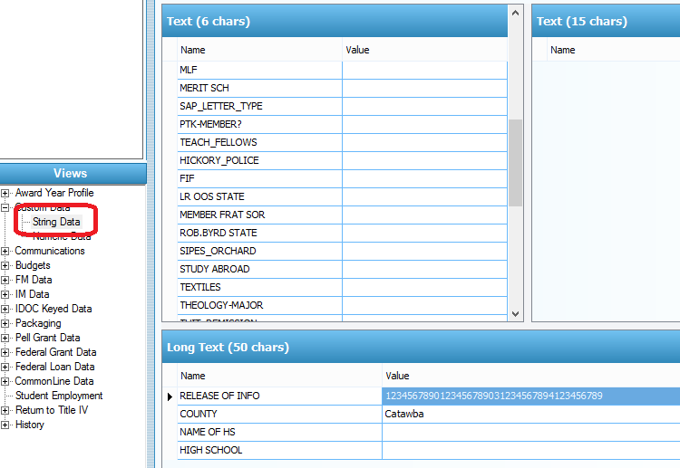
What are the types of fields in Custom Data?
Those fields dealing with text (non-numeric) are:
  Text (6 chars) is user_string
  Text (15 chars) is user_mediumstring
  Long Text (50 chars) is user_long

Slide 6
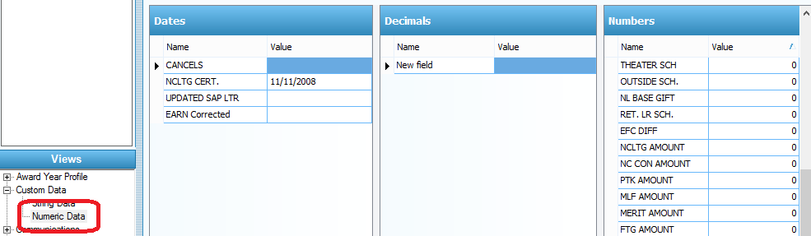
What are the types of fields in Custom Data?
Those fields dealing with numbers are:
  Dates is user_date
  Decimals is user_decimal
  Numbers is user_int

Slide 7

How does data get into Custom Data fields?
Manually
Imported via External Update*
PIT Rules
*If you are loading data directly to these fields without going through Data Integration, you are not in compliance with your user agreement.

Slide 8
How can the data in Custom Data fields be used?
Assigning POEs
Budgets
Institutional selection for verification
Missing information letters
Automated packaging
Reporting

Slide 9
How do I setup a Custom Data field?
Let’s take PowerFAIDS for a test drive…

Slide 10

Questions?

Slide 11
Apple Pi Consulting, limited
Does it have to do with PowerFAIDS?
Yeah, Apple Pi Consulting does that.
Valerie A. Mockus, MBA
President
valerie@apple314.com
740.403.3951

