Slide 1
PowerCampus Users Group
It’s our community
Presented by: Adrian Smith, Director of Administrative and Enrollment Systems
Metropolitan College of New York
June 19, 2015

Slide 2
PCUG - Purpose
  Provide suggestions and guidance to Ellucian regarding the needs and uses of the PowerCampus software and any integrated systems, for the improvement of the system(s) and for the benefit of the PCUG members;
  Foster and improve relationships and lines of communication among PCUG members and between members and Ellucian, and
  Provide support, education and information to the PCUG members.

Slide 3
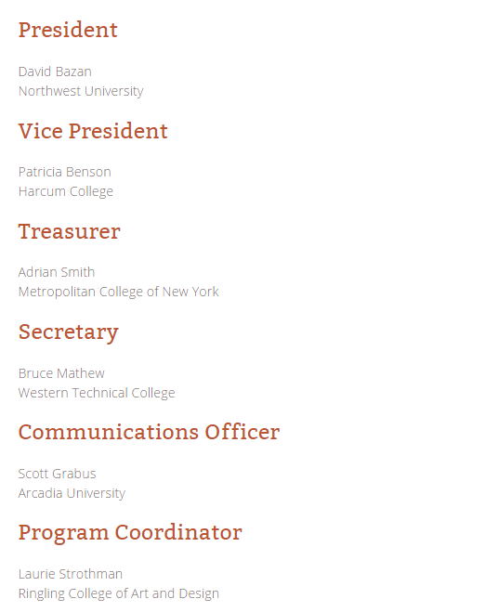
Officers
April 2015 – March 2016

Slide 4
Institution Membership
Annual $150 for July – June membership year
How can we join?

Slide 5
PCUG Activities
  PCUG email newsletter
  PCUG Discuss events
  PCUG regionals
  Community involvement
    eCommunities
    Directly between schools
  Advocacy for needed changes

Slide 6
How can I get involved?
  Attend regional user group meetings
  Join the newsletter
  Be a part of PCUG Discuss events
  Contribute within eCommunities

Slide 7
How can I get involved?
  Coordinate a PCUG Discuss event (not necessarily as the presenter)
  Be a part of a regional user group host committee
  Volunteer to run for an elected officer position

Slide 8
What would you like to see in PCUG Discuss events this year?
?

Slide 9
Ideas for improvements that fulfill the PCUG Mission?
  Provide suggestions and guidance to Ellucian regarding the needs and uses of the PowerCampus software and any integrated systems, for the improvement of the system(s) and for the benefit of the PCUG members;
  Foster and improve relationships and lines of communication among PCUG members and between members and Ellucian, and
  Provide support, education and information to the PCUG members.

Slide 10
Thank you!
Presented by: Adrian Smith, Director of Administrative and Enrollment Systems
asmith@mcny.edu
Metropolitan College of New York
June 19, 2015

