Slide 1
Making the Most of the
Ellucian Support Center
Presented by: Sharon Burman, Software Support Analyst
Ellucian
June 2015

Slide 2
Introduction
This session will provide a demonstration of the Ellucian Support Center and will include tips on how to effectively navigate and search the system.
Topics include:
  How to use customer self-help and knowledge repository
  How to search for specific CRs, Doc, Articles etc.
  How to work effectively with the Action Line

Slide 3
Agenda
1. What is the Ellucian Support Center?
2. Ellucian Support Center Navigation
3. Searching for Articles, Defects, Documentation, etc.
4. Effectively working with the Action Line
5. Submitting, Promoting, and Demoting Ideas

Slide 4
What is the Ellucian Support Center?
The Support Site for ALL Ellucian Clients
https://ellucian.okta.com/ (or from the Ellucian web site)
The Repository for:
  Knowledge Articles
  Documentation
  Change Requests (Defects and Enhancements)
  Ideas
  Support Cases
  Links to Download Code, eCommunities, Ellucian Forums

Slide 5
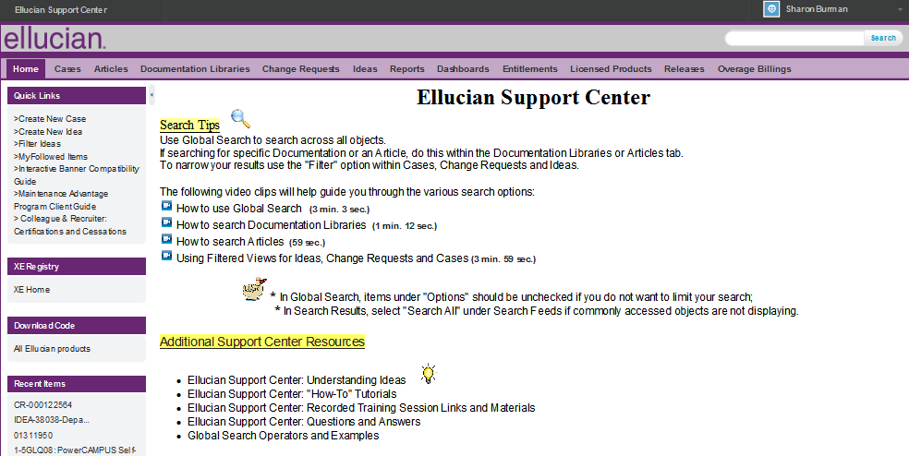
Navigation: The Home Tab
Global Search
Tabs
How to video clips
Left Sidebar
Tips

Slide 6

Finding Information in the Ellucian Support Center

Slide 7
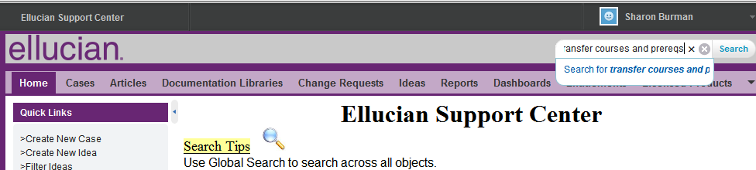
Global Search – Strings of Words Without Quotes
Enter: transfer courses and prereqs

Slide 8
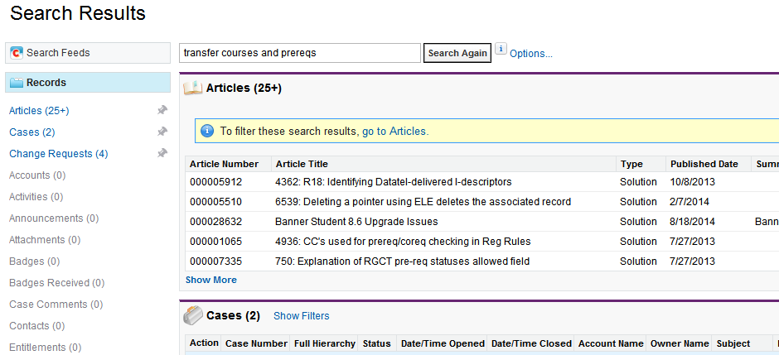
Global Search – Strings of Words Without Quotes Results

Slide 9
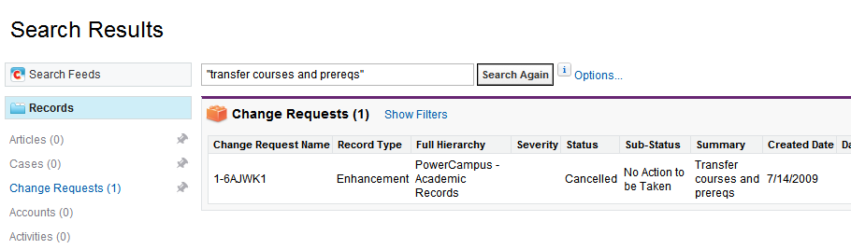
Global Search – Strings of Words With Quotes

Slide 10
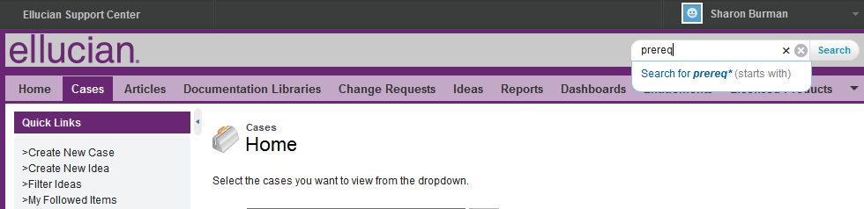
Global Search – Using an Exact Object Value
Enter: prereq

Slide 11
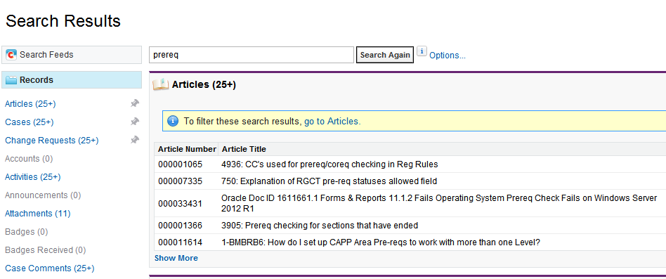
Global Search – Using an Exact Object Value Results

Slide 12
Global Search – Searching with and without Wildcards
Wildcards:
  ? = Single-character wildcard
  * = Multiple-character wildcard
The following examples will demonstrate the difference between:
“Release 8.6.1”
“Release 8.??”
“Release 8*”

Slide 13
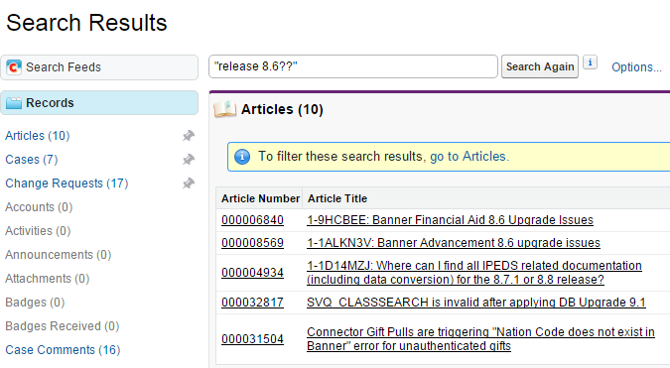
Global Search – Using a Single-Character Wildcard (?) Results

Slide 14
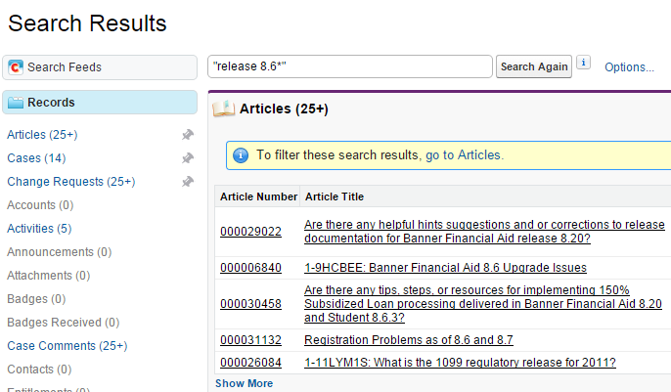
Global Search – Using a Multi-Character Wildcard (*) Results

Slide 15
Global Search – Other Operators
You can also use:
  AND: xxxxx AND yyyyy
  OR: xxxxx OR xxxxx
  AND NOT: xxxxx AND NOT yyyy
  Parentheses (): (xxxxx AND yyyyy) OR zzzz

Slide 16
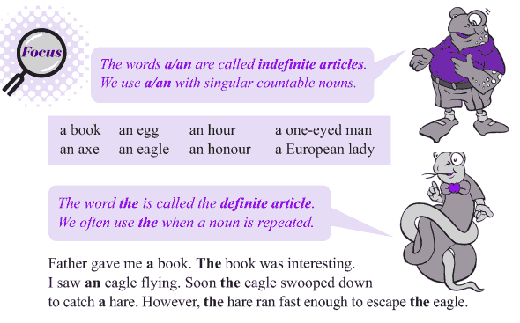
Article Features

Slide 17
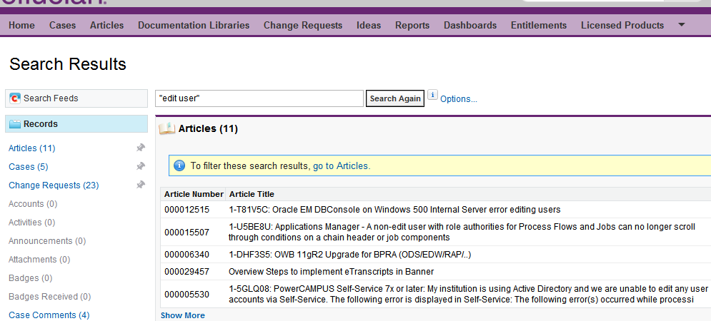
Article Results

Slide 18
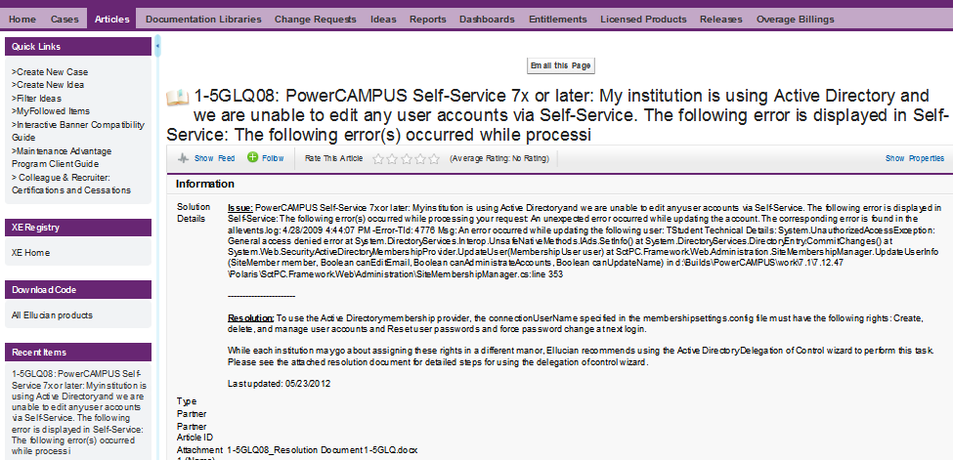
Article Features: Email this Page, Attachments, Follow, Rate, Properies

Slide 19

Change Request Filtering

Slide 20
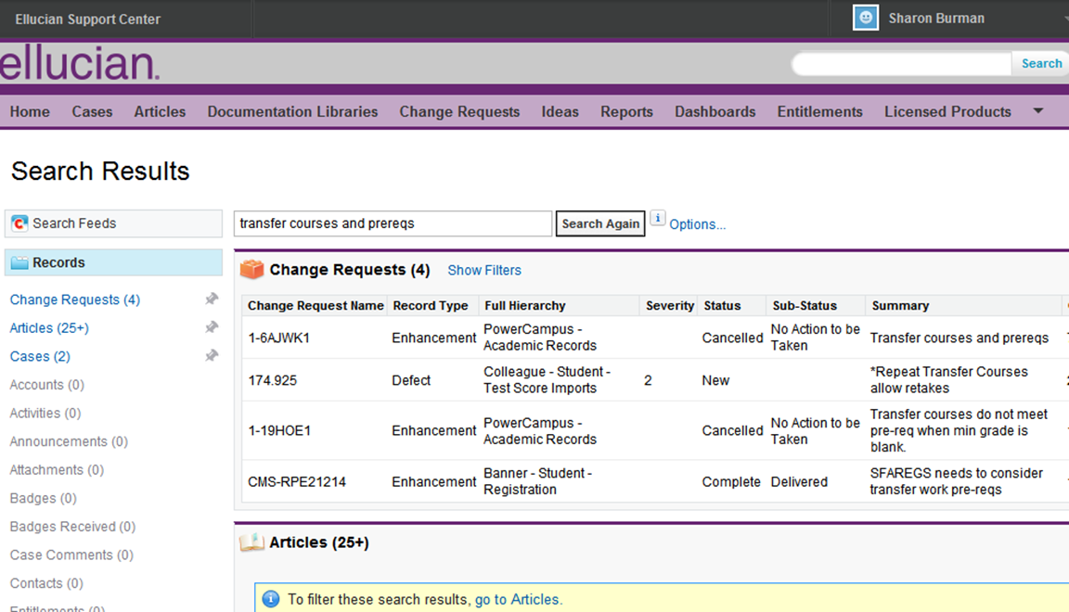
Filtering Options

Slide 21
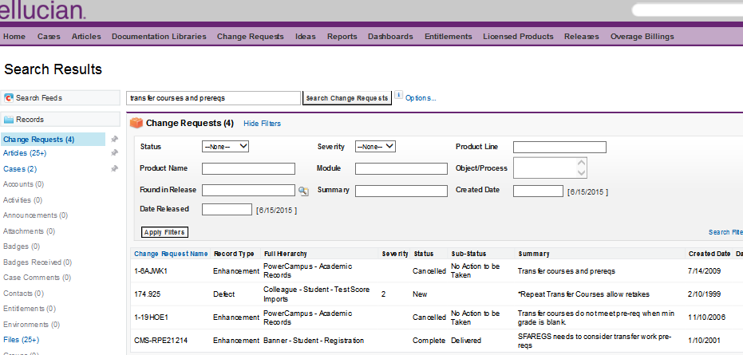
Change Request Filters – Uses “Contains”, No Wildcards

Slide 22
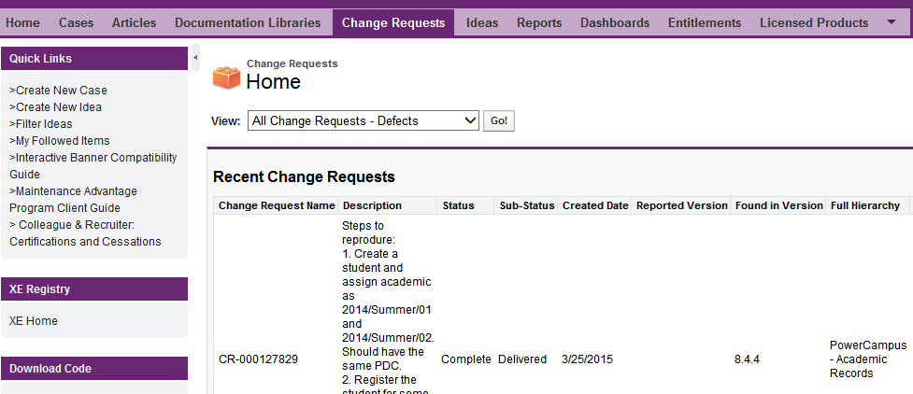
Advanced Change Request Filtering – Accessed via Views

Slide 23
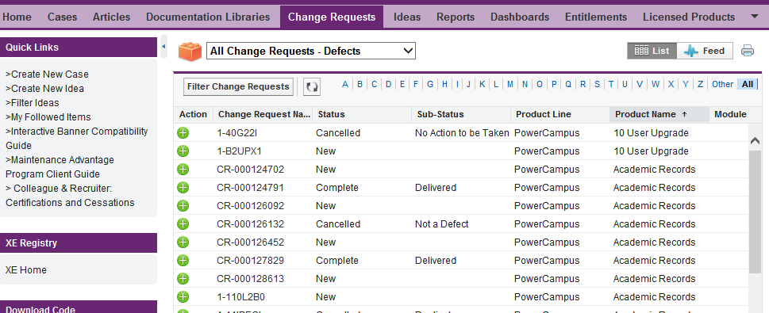
Advanced Change Request Filtering – Must Press GO

Slide 24
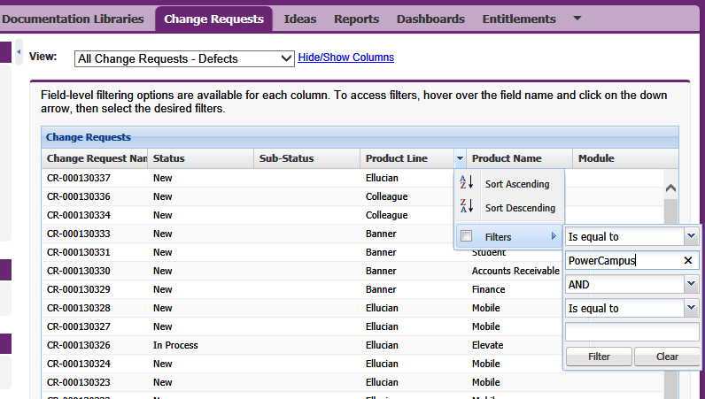
Advanced Change Request Filtering – Filter Multiple Columns

Slide 25
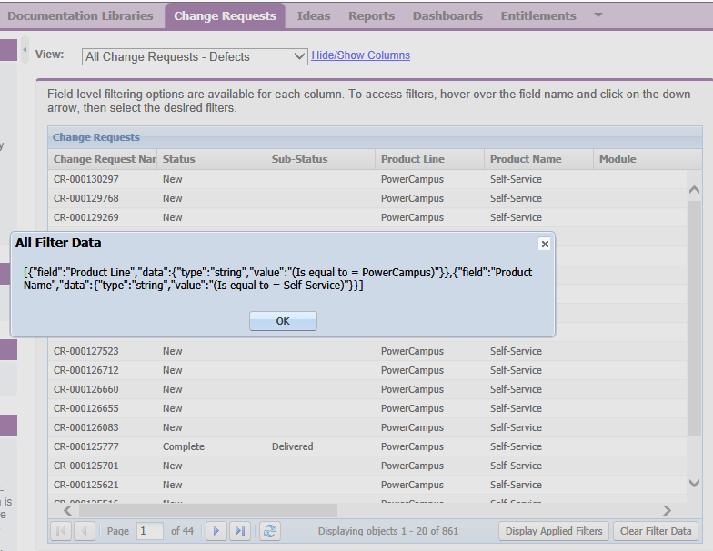
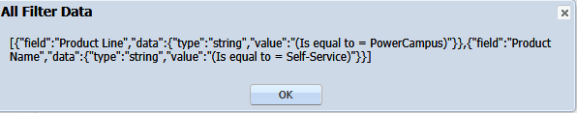
Advanced Change Request Filtering – Display Applied Filters/Clear Filter Data

Slide 26

Documentation Libraries

Slide 27
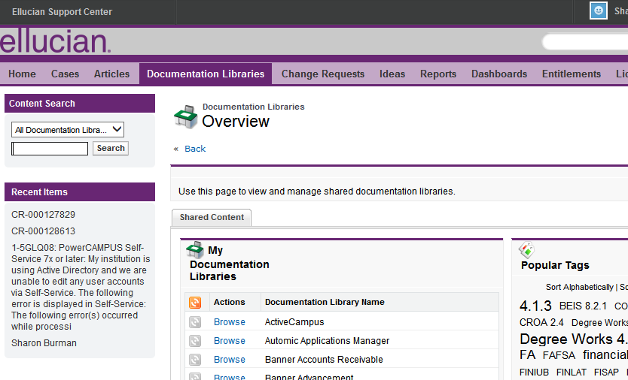
Documentation Libraries Tab

Slide 28
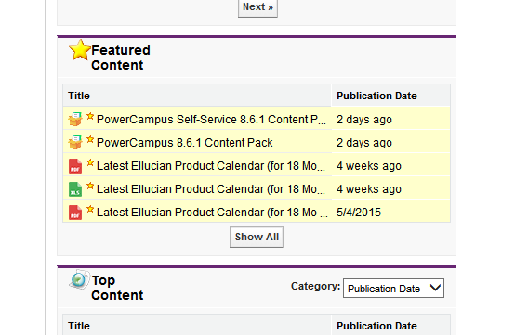
Documentation Libraries – Featured Content

Slide 29
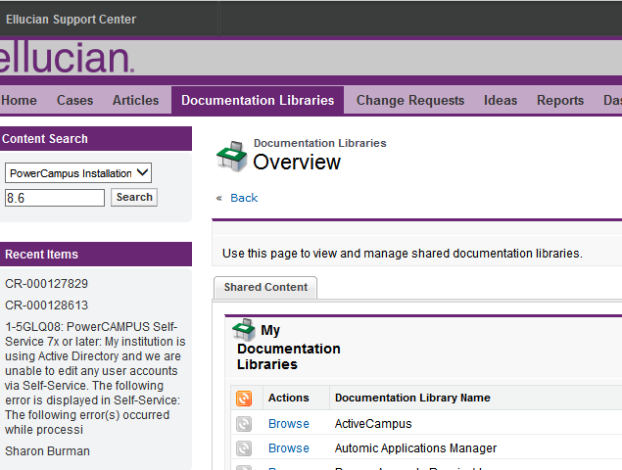
Documentation Libraries – Content Search

Slide 30
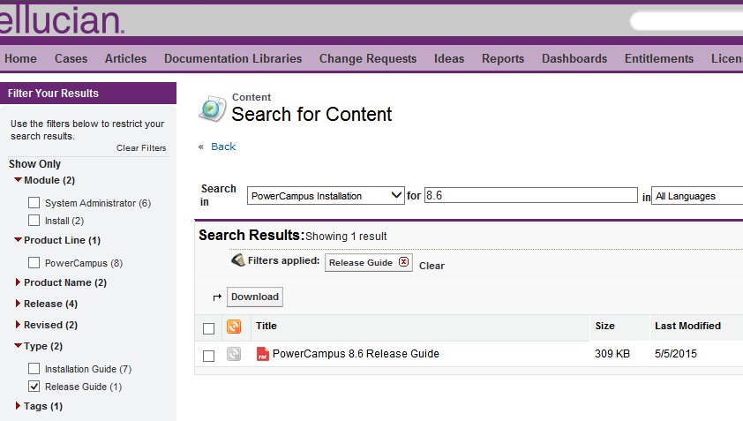
Documentation Libraries – Content Search Filters

Slide 31
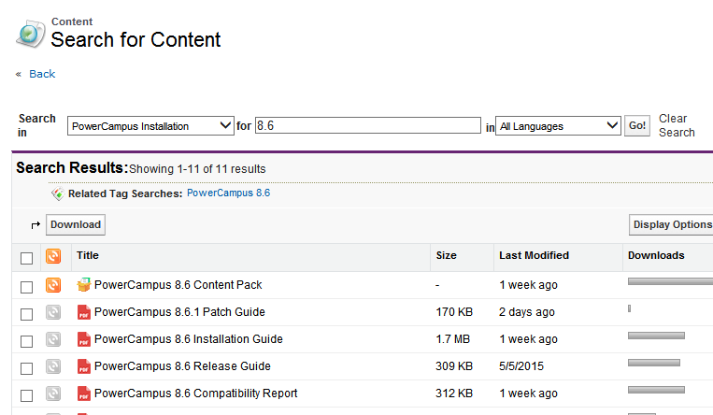
My Documentation Libraries - Subscribe

Slide 32

Case Management

Slide 33
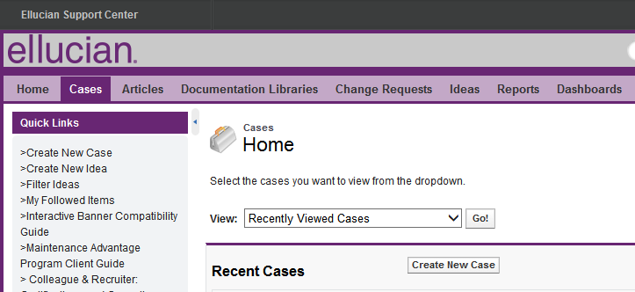
Create New Case

Slide 34
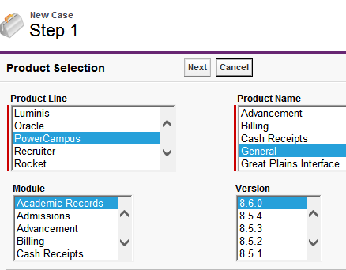
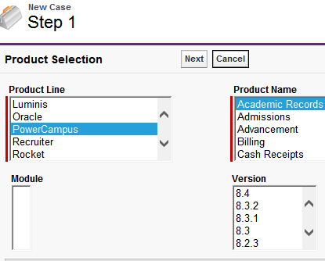
Create a Case – Step 1: Product Selection
For anything other than Self-Service, be sure to select General for Product Name
Incorrect

Slide 35
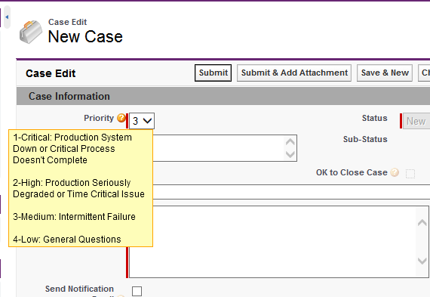
Create a Case: Select Priority

Slide 36
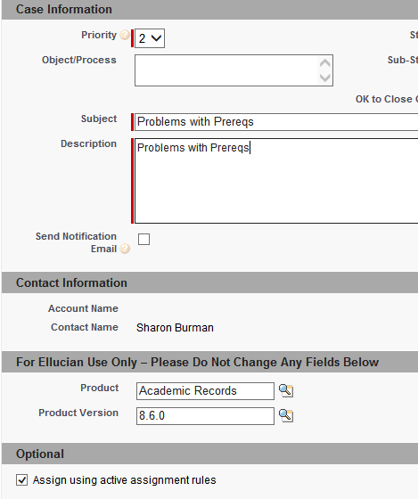
Create a Case – DO NOT Modify the For Ellucian Use Only Section

Slide 37
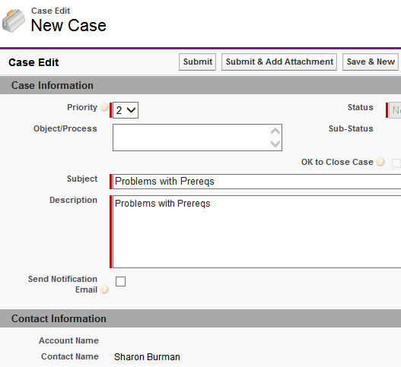
Create a New Case: Submit
Include as many details as possible. For example:
Screen shots
Path/Steps taken, if known.
Log files
If there is any PII, use Confidential Attachments and Notes

Slide 38
Ways to Access an Existing Case
1. From Recent Items
2. Using Global Search
3. Through the Cases Tab Using Views
4. Using Case Number

Slide 39
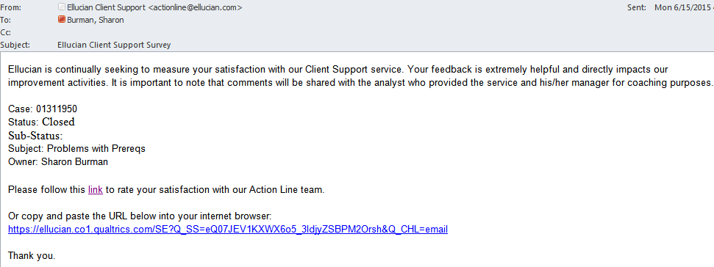
Please Complete the Ellucian Client Support Survey

Slide 40

Ideas

Slide 41
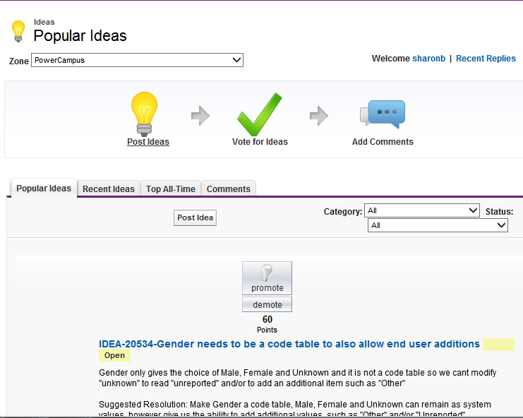
Suggest and Vote on Potential Product Enhancements

Slide 42
Important Notes about Ideas
Every Ellucian Support Center User Can …
  View, Create and Comment on Any Idea
  Vote For (Promote) or Against (Demote) a Particular Idea Only Once
Ideas are reviewed and prioritized regularly.
Only the Product Owner can change an Idea into a Change Request-Enhancement

Slide 43
Summary
Use Global Search to find Change Requests, Doc, Articles, etc.
  Use quotes around strings: “xxxxx yyyy zzzzz”
  Use Wild Cards: * and ?
  Use AND, OR, AND NOT and parentheses ( )
  Pin frequently searched categories to the top of the list

Slide 44
Summary - Continued
Use Filters on Change Requests and Cases to search using multiple criteria.
Use Documentation Libraries to Download Ellucian-authored Documentation
  Find the Ellucian Product Calendar under Featured Content
  Use Content Search and Type to find specific types of Documents for a product.
  Subscribe to a Documentation Library to receive email notifications of new postings

Slide 45
Summary - Continued
Use Cases to effectively communicate with the Action Line.
  Set the appropriate priority
  Provide a detailed description and attachments
  Use “Confidential Attachments & Notes” for PII
  Use “OK to Close” or Comments to notify Action Line to close a case.
  Follow a colleague’s case to receive notifications of updates.
  Complete the Ellucian Client Support Survey
Use Ideas to request, promote or demote proposed product enhancements.

Slide 46

Questions & Answers

