Slide 1
Ellucian Health Check:
A Customer’s Perspective
Presented by: Chad Strunk, Manager of IT Systems
Dunwoody College of Technology
June 19, 2015

Slide 2
Topics
Why we did the Health Check.
The Health Check Experience
Results and Outcomes
Q&A
Notes:
Topics
This session is a review of Dunwoody’s experience with the Ellucian Health Check. The topics we shall cover today include why we decided to conduct the Health Check, what happened during the Health Check, and what we did with the results we received from it.

Slide 3
Why we did the Health Check.

Slide 4
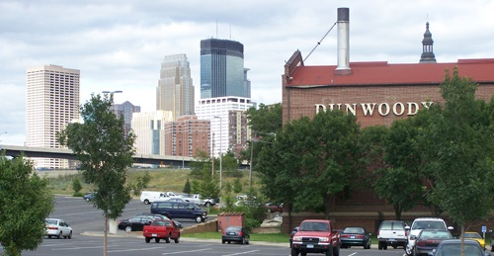
Notes:
About Dunwoody
Dunwoody College of Technology is a private, not-for-profit, endowed institution of higher education founded in 1914 in Minneapolis, MN. We are the only not-for-profit technical college in the Upper Midwest. We offer 28 associate and 5 bachelor’s degree options as well as 11 certificate and diploma programs all designed to provide students with the skills they need to “fit themselves for the better performance of life’s duties”.
We had 1070 students enrolled in for-credit courses last fall. We have a strategic goal to increase enrollment to over 1600 students by 2020. In order to do that with such a small staff, we need to have our systems make the repetitious processes easy for both the students and employees.
Furthermore, as a “College of Technology”, our digital services must match our name.

Slide 5
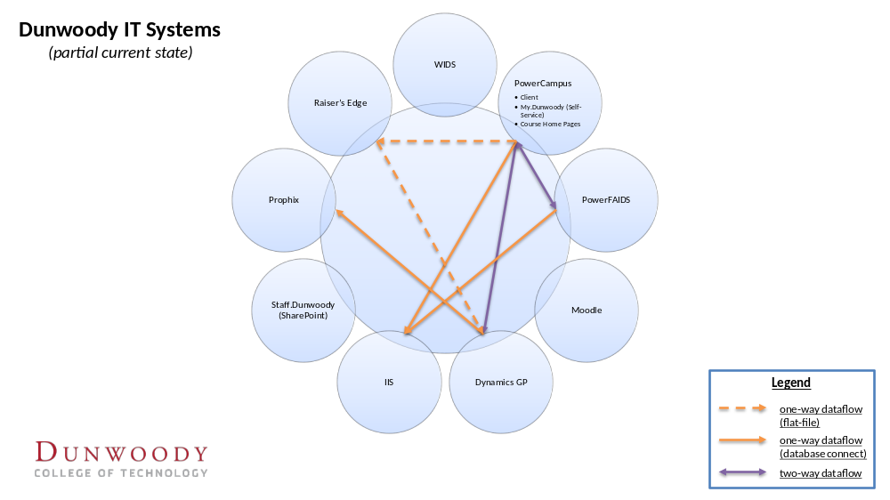
Notes:
Our Business Systems
According to the notes I can find, Dunwoody purchased PowerCampus in approximately 1996. Our oldest record in ACADEMIC is an inquiry in November 1997. We use PowerCampus for admissions, student records in the credit school, and student billing.
We integrate PowerCampus with Dynamics GP, PowerFAIDS, and our home-built reporting system. Other non-integrated systems include Raiser’s Edge, Moodle, WIDS, a SharePoint-based intranet site, and a home-built multi-system reporting website we call IIS.
Throughout the years, we solved problems using workarounds, bypasses, and/or customizations. For example, IIS is a workaround for reporting. In it we've built pages to assess fees to students for the Bursar's office and to change the college attend field enmass for student records. Another workaround is our 1098T queries. I run a set of queries every year to create a file for a third-party processor rather than running 1098T through PowerCampus.

Slide 6
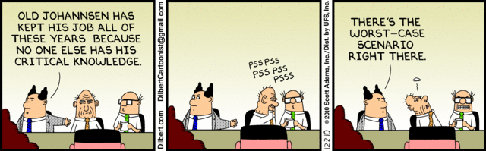
Notes:
As we upgraded, we ignored some new features in PowerCampus because of lack of funding, time, or understanding. They became “someday” projects to tackle when we had enough time and resources. Of course, we couldn't have predicted things like the Great Recession that would decimate our staff and our ability to adjust to changes in our workload.
Despite this, our workarounds grew and took on lives of their own. Piece-by-piece, we were replicating the functionality of PowerCampus. As I said, things like 1098T, payment plans, and satisfactory academic performance are processed with ancillary queries and webpages.
As time passed, personnel turnover forced peer-to-peer training and processes became tribal knowledge. I experienced this personally when I assumed administration responsibility over PowerCampus a couple of years ago. I couldn’t get training, and I quickly found that I couldn’t get training for anybody.

Slide 7
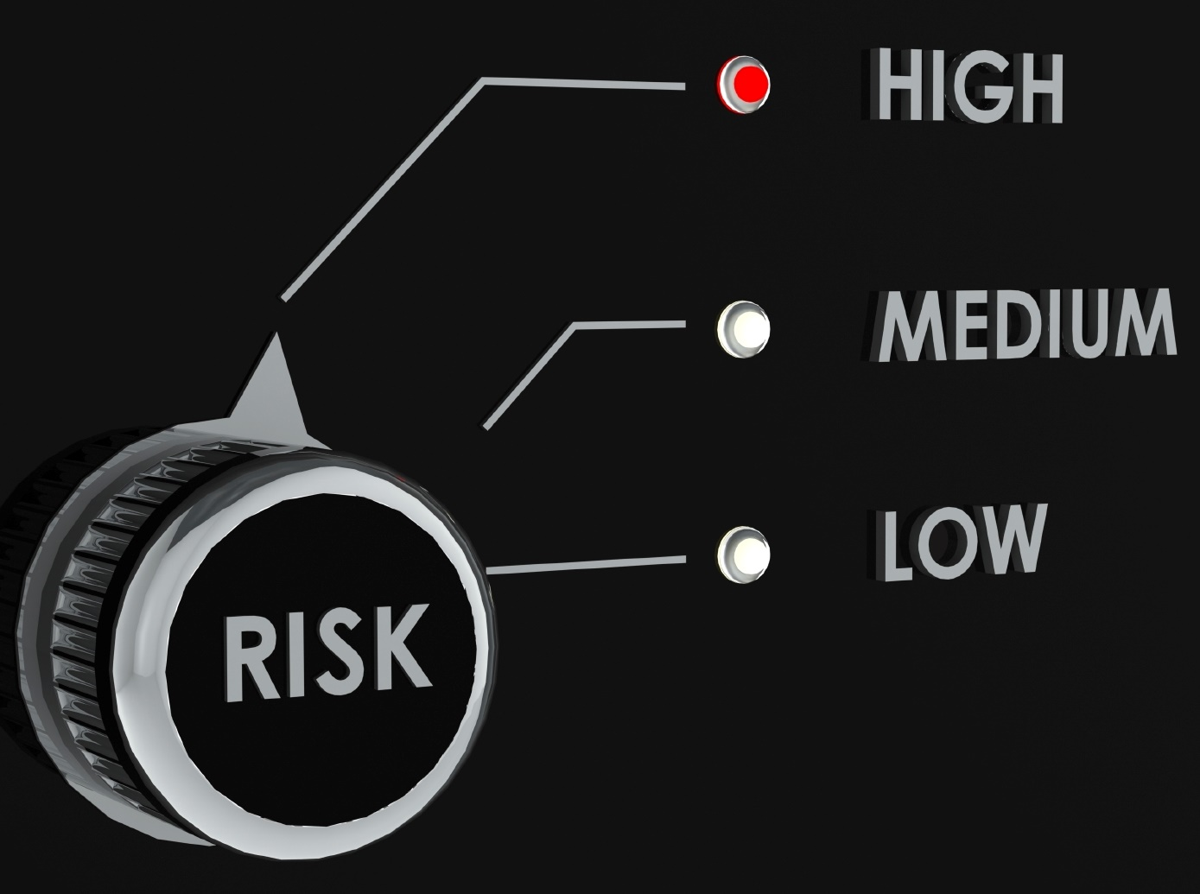
Signs of Trouble
Notes:
Signs of Trouble
We are the only PowerCampus client in Minnesota. The closest PowerCampus client to us is in Wisconsin. Unlike other colleges in our area that use Banner, and there are a lot of colleges, we don’t have a pool of experienced personnel in the area to help maintain a pool of local experience. By 2012, we were finding that we couldn’t train our own people and I, a guy that hadn't programmed since 1996 and had a history of stress-related illnesses, was responsible for keeping a core IT system alive. Thus, our president’s cabinet labeled PowerCampus as a high business risk due to the lack of training opportunities and local expertise. To address this risk, they began making preparations to replace PowerCampus. In fact, our CFO at that time was so focused on replacing PowerCampus that she refused my initial suggestion that we do the Health Check.
Last year, I had a enough buy-in from our CFO to take up Ellucian’s offer of a Health Check. It was clear that no matter how much they wanted to replace PowerCampus, it was here now and there was too much wrong to keep to the status quo. They had to invest some money into it, especially considering the strategic plan goals, and the recommendations from the Health Check were the best way to get a list of improvements.

Slide 8
Health Check Experience

Slide 9

Planning the Health Check
Notes:
Planning
One of the conditions of the Health Check is that VP participation was required. Ellucian requires this because they want things to actually happen after the Health Check. They want some commitment from the institution and requiring VP participation is an effective way to get this done.
I can tell you from a project management standpoint that I whole-heartedly agree with this condition. These people are your project champions, so if you cannot get them on-board, then your projects will have a tough go and probably fail.
I would be willing to guess that the folks at your institution are just as busy people at my institution, so you can imagine that finding free time in their schedules is HARD. We had to look at a couple of months to find a a couple of days when our VPs, college staff, and Ally’s team were free; however, I think I can say that as far as the Health Check is concerned, planning dates to meet is the hardest part of the whole experience.

Slide 10

The Interviews
Notes:
The Interviews
Ally and RuAnn were on-site for two days in November. (You know they're serious when people come to Minnesota in November.) We started with a whole group session with all departments, then individual departments, and finally an executive debriefing. Each individual session had to answer three questions: what we did well, what we did okay, and what we did poorly.
In the individual department sessions, after hearing answers to those three questions, Rue Ann walked through how PowerCampus and other products could help solve their key problems. (Assuming, of course, it was setup correctly and they knew how.) In the session with Admissions, one person declared that we could have a 10% increase if we just implemented these things in PowerCampus.
The last meeting was with the VPs. I wasn’t at this meeting, but what they heard must have been special because afterwards my boss found me and apologized for not investing enough into PowerCampus.

Slide 11

Deliverables and Debriefing
Notes:
Deliverables and Debriefing
Whereas coordinating schedules was the hardest thing to do for the Health Check, waiting for the results was the second hardest. People WANTED what they saw. Not only did I have to wait for the results, but also I had to tell folks they had to wait for the fixes to PowerCampus AND the new solutions.
A few months after the on-site meetings, we got back a summary of the sessions – including the aforementioned 10% increase – a list of improvements using consulting, training for each department, and a list of new products to add. Ally came back to debrief with the VPs. Again, I wasn’t there, but again it had to be special. They were excited and I got a green light for the projects.

Slide 12
Results and Outcomes

Slide 13

Systems User Group
Notes:
Systems User Group
During the Health Check, it became clear that we needed to have a venue for discussing the overall strategy for our business systems and our interdepartmental processes. While we waited for the results and still had some momentum from the Health Check, we created a Systems User Group soon after the Health Check to talk through these problems. My boss and I are co-chairs of the group.
We have approximately 30 members in the group representing all of the departments across the organization and the VP to which they report. Our first meeting was at the end of March when we reviewed the results from the Health Check. In April, we discussed their pet peeves, which I will use to prioritize improvement projects such as consolidating systems and integrating what is left. Last month we had a demonstration of Ellucian Portal.

Slide 14

Refit Project
Notes:
Refit Project
As I said before, one of the deliverables was a list of projects and training delivered by Ellucian consultants. I have termed this as our Refit Project for PowerCampus and Dynamics GP. This project will span the entire 15-16 academic year.
This project started last month. It starts with a series of audits to further refine the recommendations from the Health Check and see just how out of spec we are. It follows up with subprojects to address some of the known functionality problems and upgrade to Dynamics GP 2013 and, in my opinion, the most important part, staff training.
Lastly, we have a series of training engagements for each office depending upon their level of training. We knew before the Health Check, and confirmed during the Health Check, that no one in the college has any significant training. I expect this will have one of the biggest impact upon our productivity.

Slide 15

Notes:
New Products
The last part of the deliverables was a list of new products we should add to improve user experience and productivity. Included in this is Ellucian Portal, Mobile, LMS integration, and Analytics. These projects will commence in the next fiscal year after we complete the bulk of the Refit projects.

Slide 16
Takeaways
Notes:
Takeaways
We found the Health Check to be a valuable experience that told us a lot about things we didn’t know and didn't know that we didn't know. It gave us a list of prioritized projects that we can use to improve productivity and experience. Although there is a sales aspect to the Health Check and we will be spending quite a bit of money over the next two years, I could argue that we should have been spending that money all along. I think we can all agree, especially considering the mission of our institutions, that training is one of the most important value-added things you can do for your staff.
Going forward, we’d like to have these checkups periodically to make sure the entire college is aware of how the systems can help them work better. I fully expect that we can improve things to handle the 500 headcount increase while reducing the burden on our staff.

Slide 17
Q&A

Slide 18
Thank You!
Chad Strunk, Manager of IT Systems
Dunwoody College of Technology
cstrunk@dunwoody.edu
612-381-3076

