Slide 1
Power Campus & E-Learning
Presented by: Victor kioulaphides, e-learning coordinator
Institution: metropolitan college of new york
Date: june 18, 2015

Slide 2
SIS meet LMS
In the beginning, there were data.

Slide 3
Courses
Integration 101

Slide 4
Shells
Virtual Seafood

Slide 5
Mapping
Roles Enrolled & Thou Shalt Nots

Slide 6
Attendance
Present Affairs

Slide 7
Grades
Making the Grade

Slide 8
LMS no SIS
Private Matters 1

Slide 9
SIS no LMS
Private Matters 2

Slide 10
Big Brother & The Art of
Record-Keeping
Registrar Dream Come True

Slide 11
In conclusion
Together forever

Slide 12
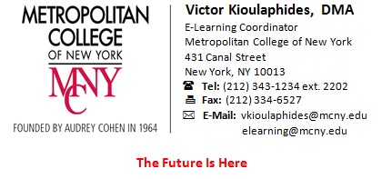
The Future Is Here

