Slide 1
ADULT LEARNER AND ONLINE REGISTRATION
Presented by: Noreen Smith, Registrar
Metropolitan college of New york
June 17, 2015

Slide 2
The MCNY Adult Learner
Overview of Metropolitan College of New York
1964 - The Women’s Talent Corps
1970 – College for Human Services
1992 – Audrey Cohen College
2002 – Metropolitan College of New York
Full-time working adults
Many are single parent caring for their children by themselves
Many are attending college for the first time

Slide 3
Before Online Registration
Before Fall 2012 (Pilot of Online Registration)
Long lines
Exhaustive wait time to see advisors
Disgruntled students
Extended working hours for staff during registration period (4-6 Weeks of extended hours)
Over-abundance of paper, including sign-In sheets, Registration Form, Student Information form to name a few.

Slide 4
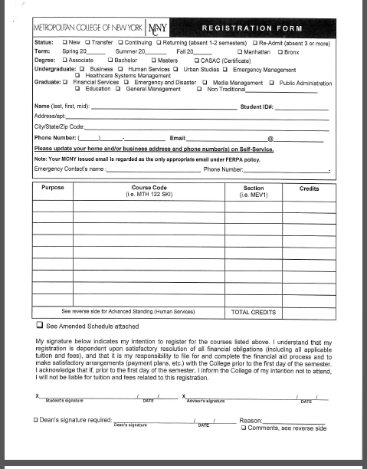
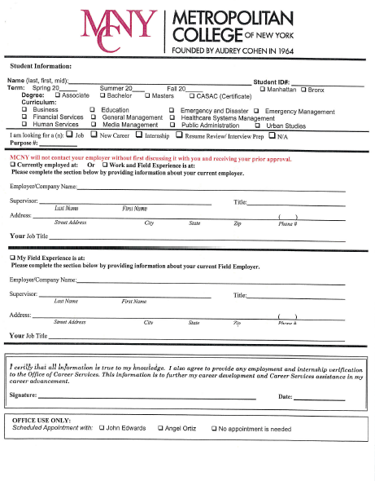
Types of Forms Student is Required to Fill out

Slide 5
Preconceived Advantages of Online Registration
No more paper: Sign-In Sheets; Student Information Form; Registration Form
Satisfied students
Less work for staff

Slide 6
Implementation: Steps Taken
Marketing the benefits of Online Registration to the community
Identifying pilot groups for testing
Training of students and staff

Slide 7
Where Are We Now
Less Paper (Sign –In Sheets, Registration Form, Printed Schedule)
Students registering earlier
Shorter lines
Advisors utilizing their expertise and advising skills in academic advising
Advisors spending more time with students who require Individualized attention
Students empowered in taking ownership of their education
Fewer days of extended hours for staff

Slide 8
Adaption Rate
Since Fall 2012

Slide 9
Where Do We Go From Here
Improving the Online registration for the Extension Site
Improving the user experience – searching for courses to be simplified

